Slide 1




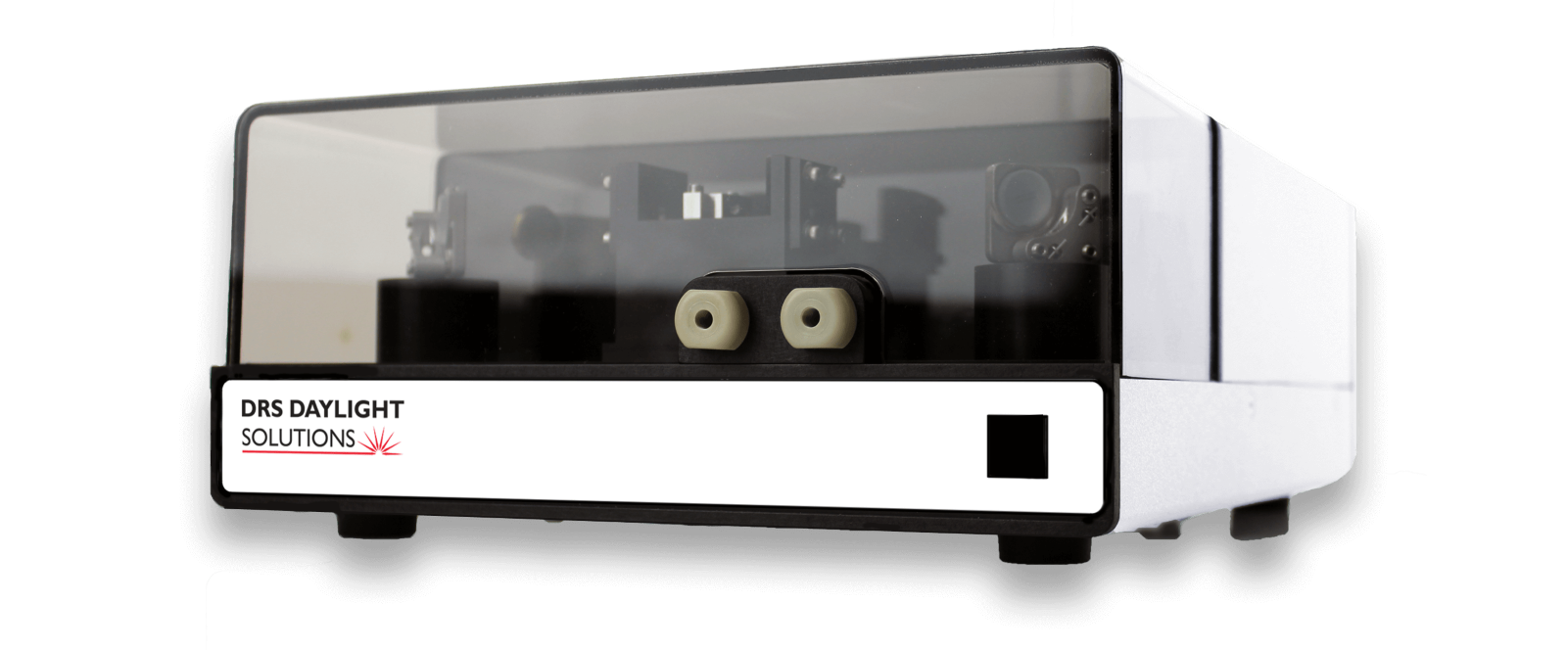
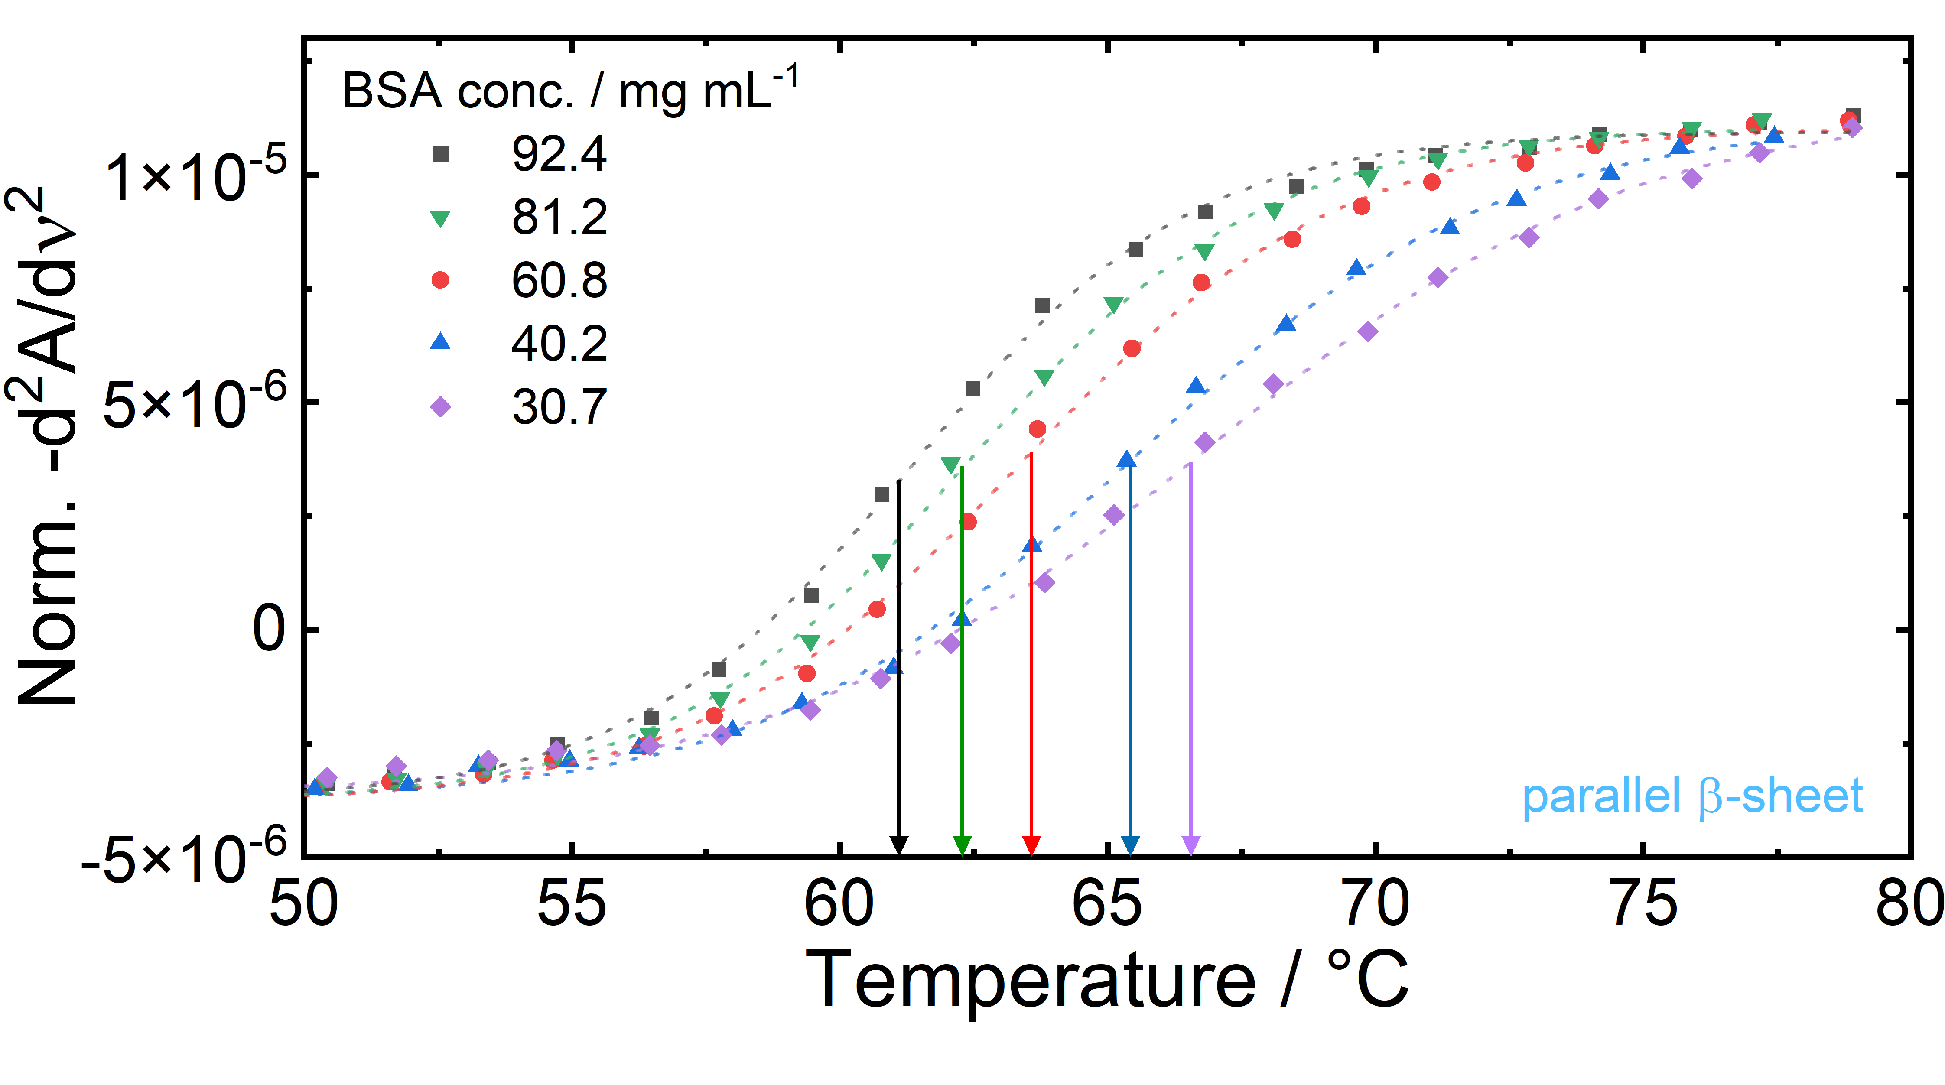
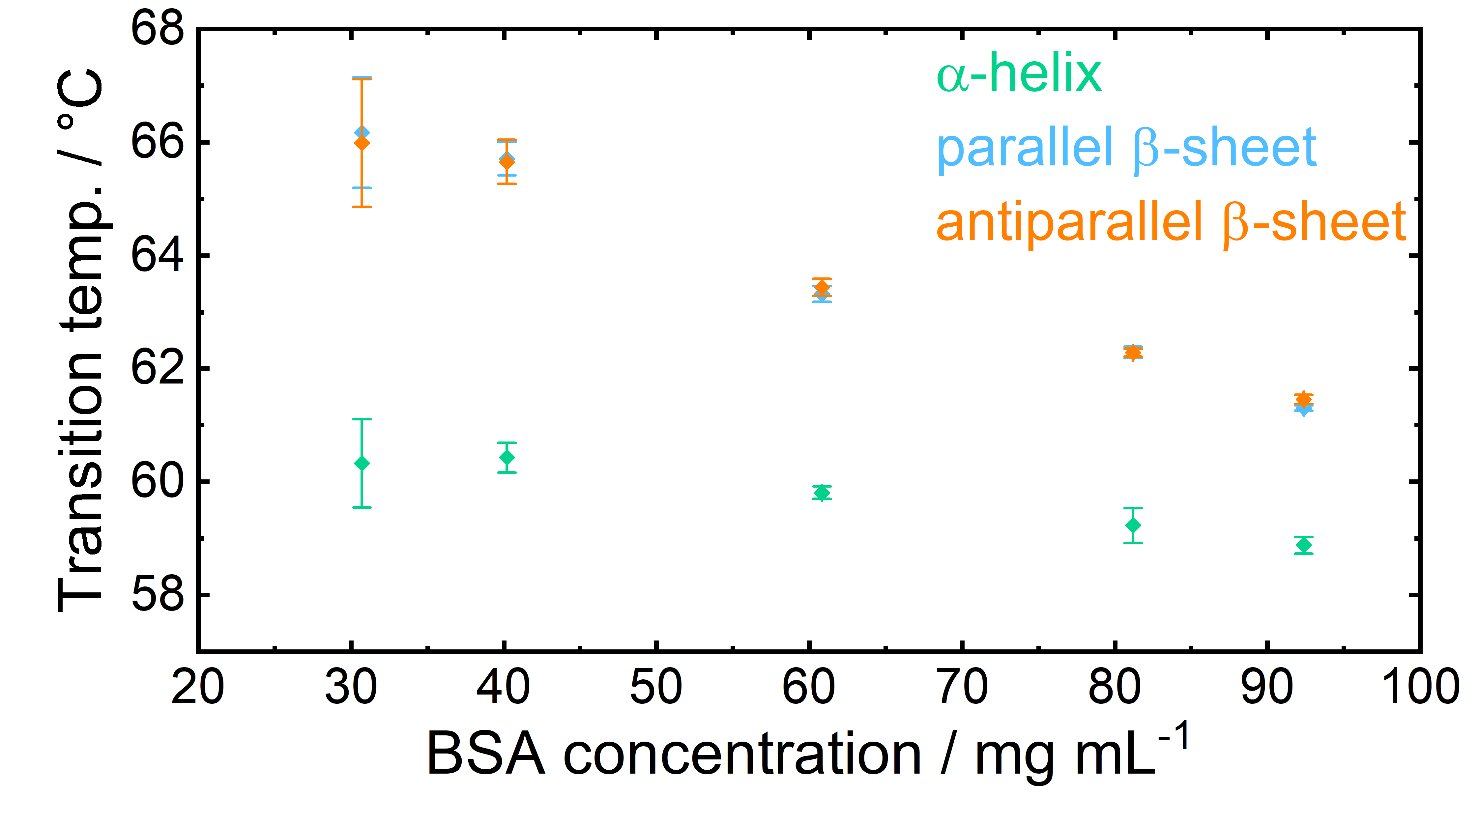
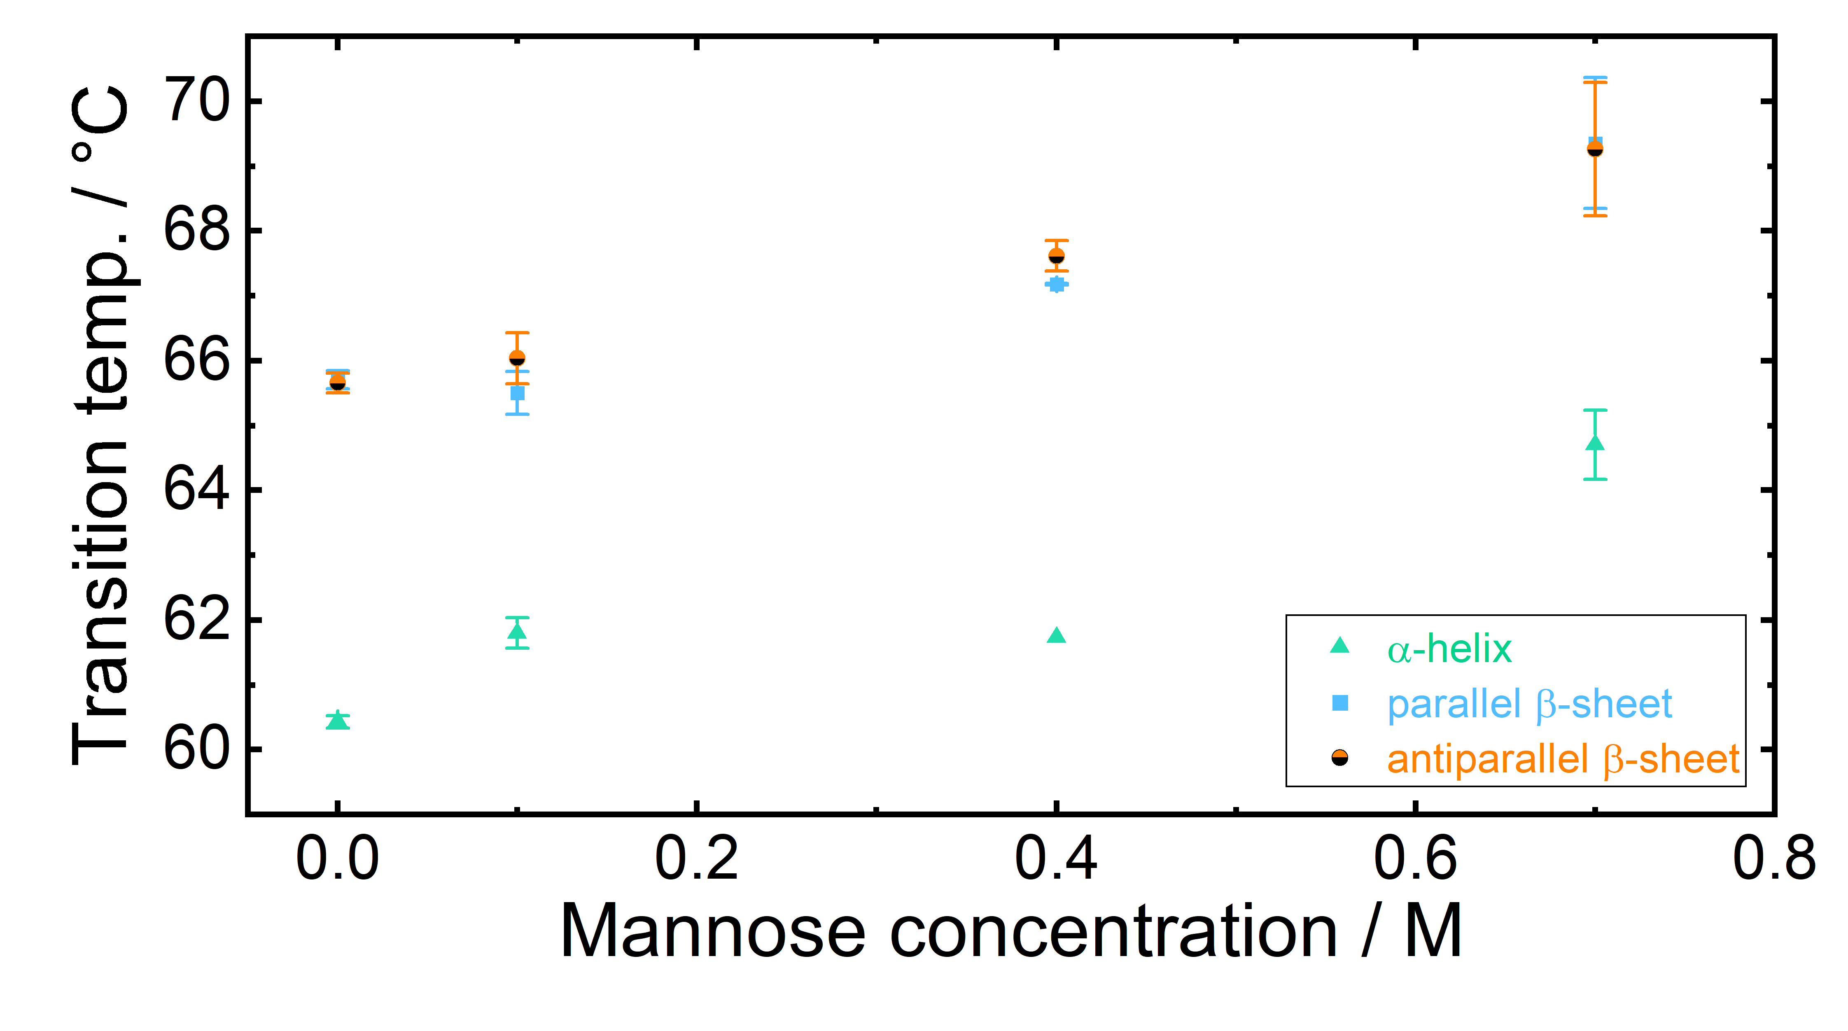
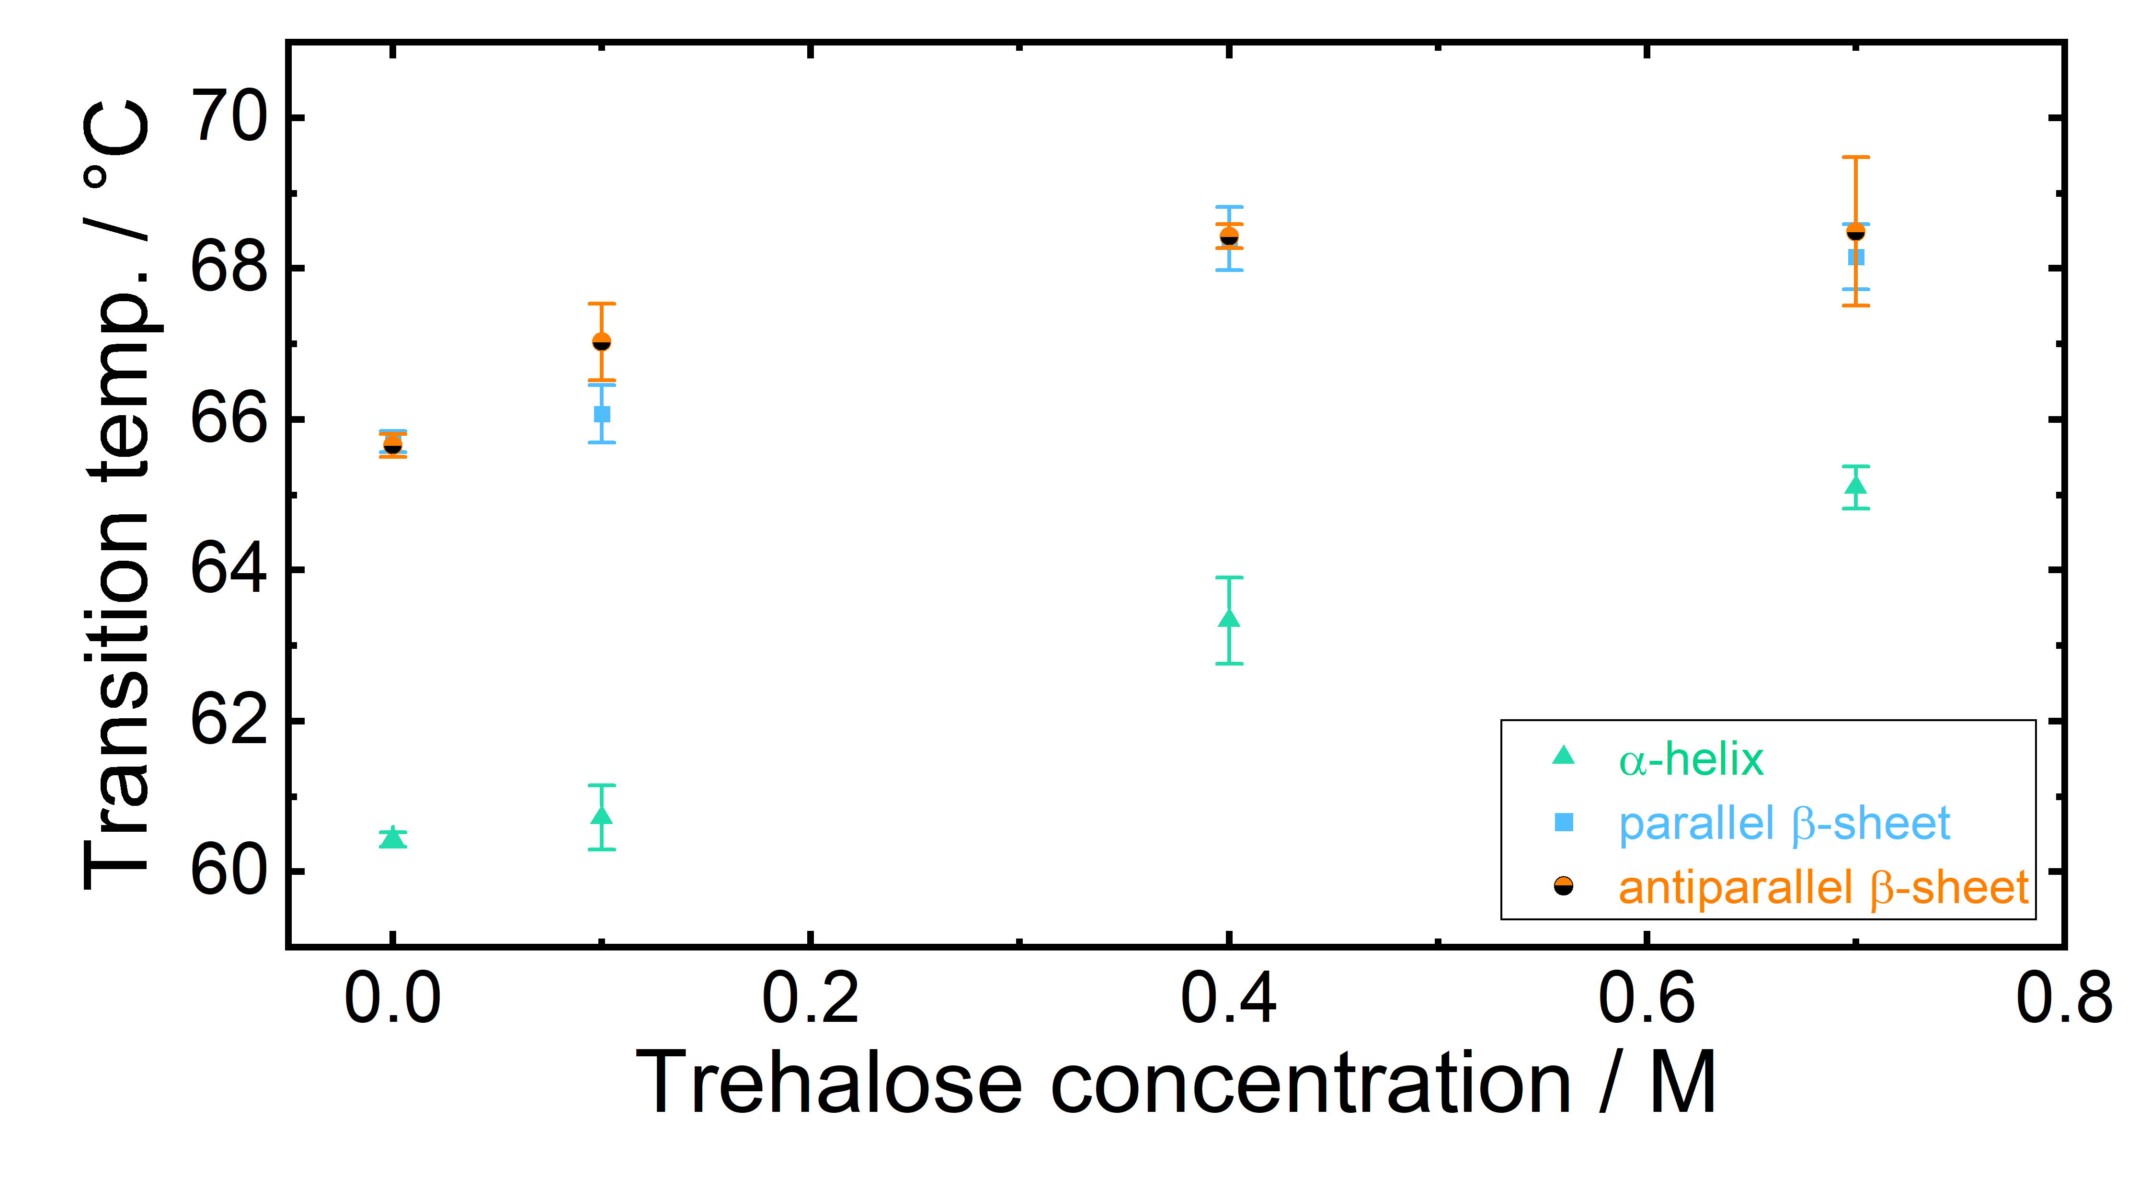
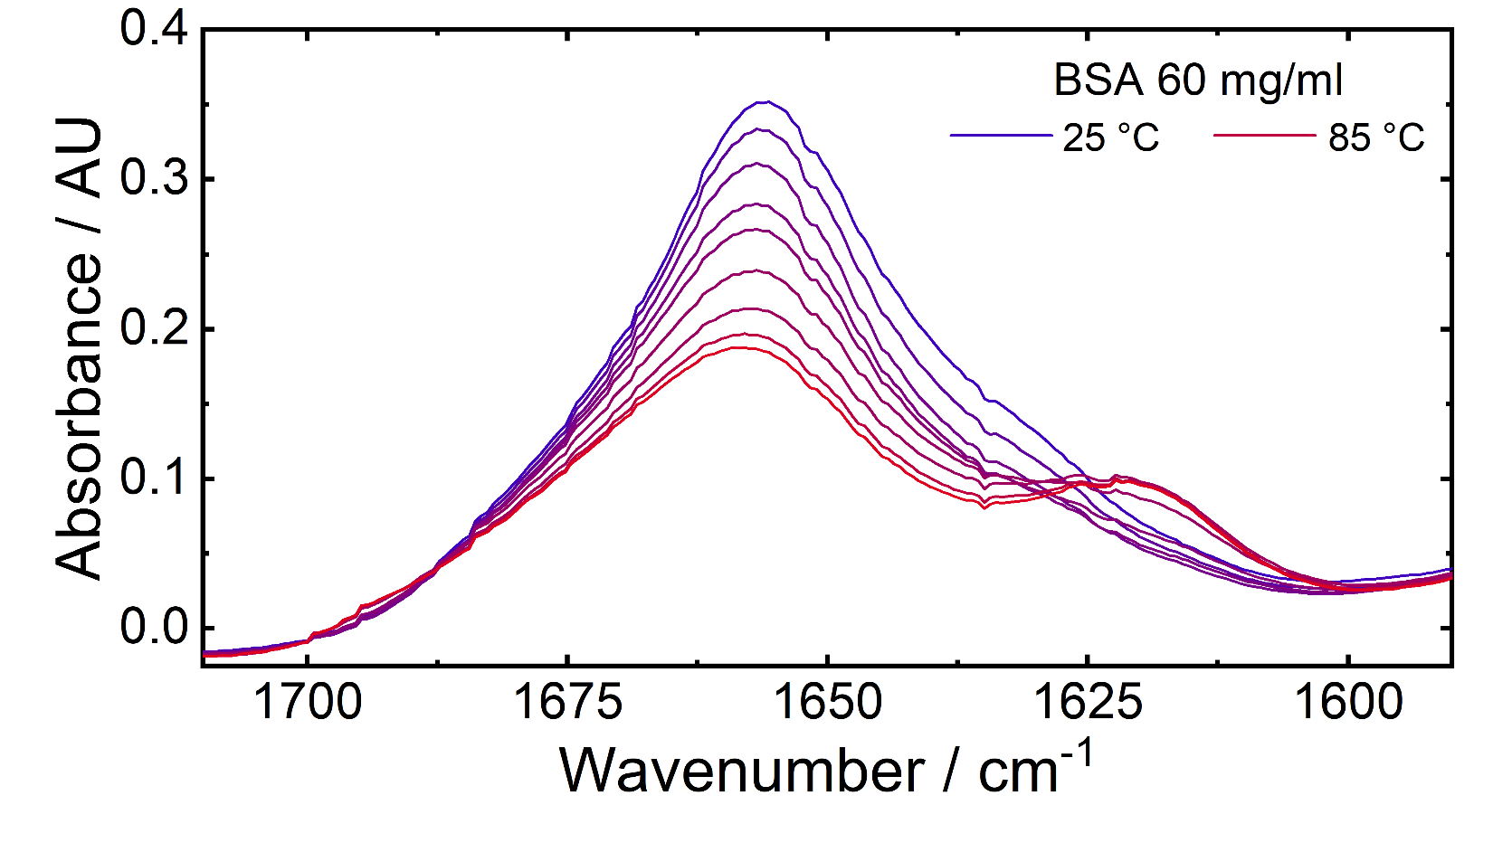
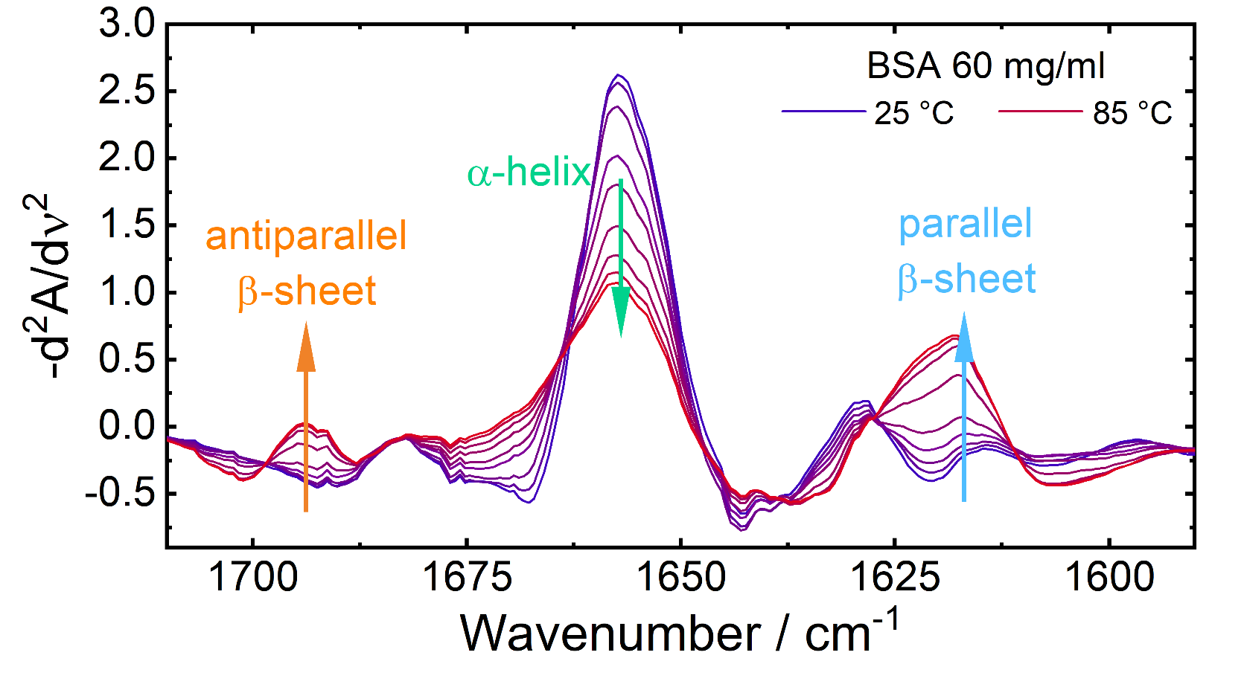
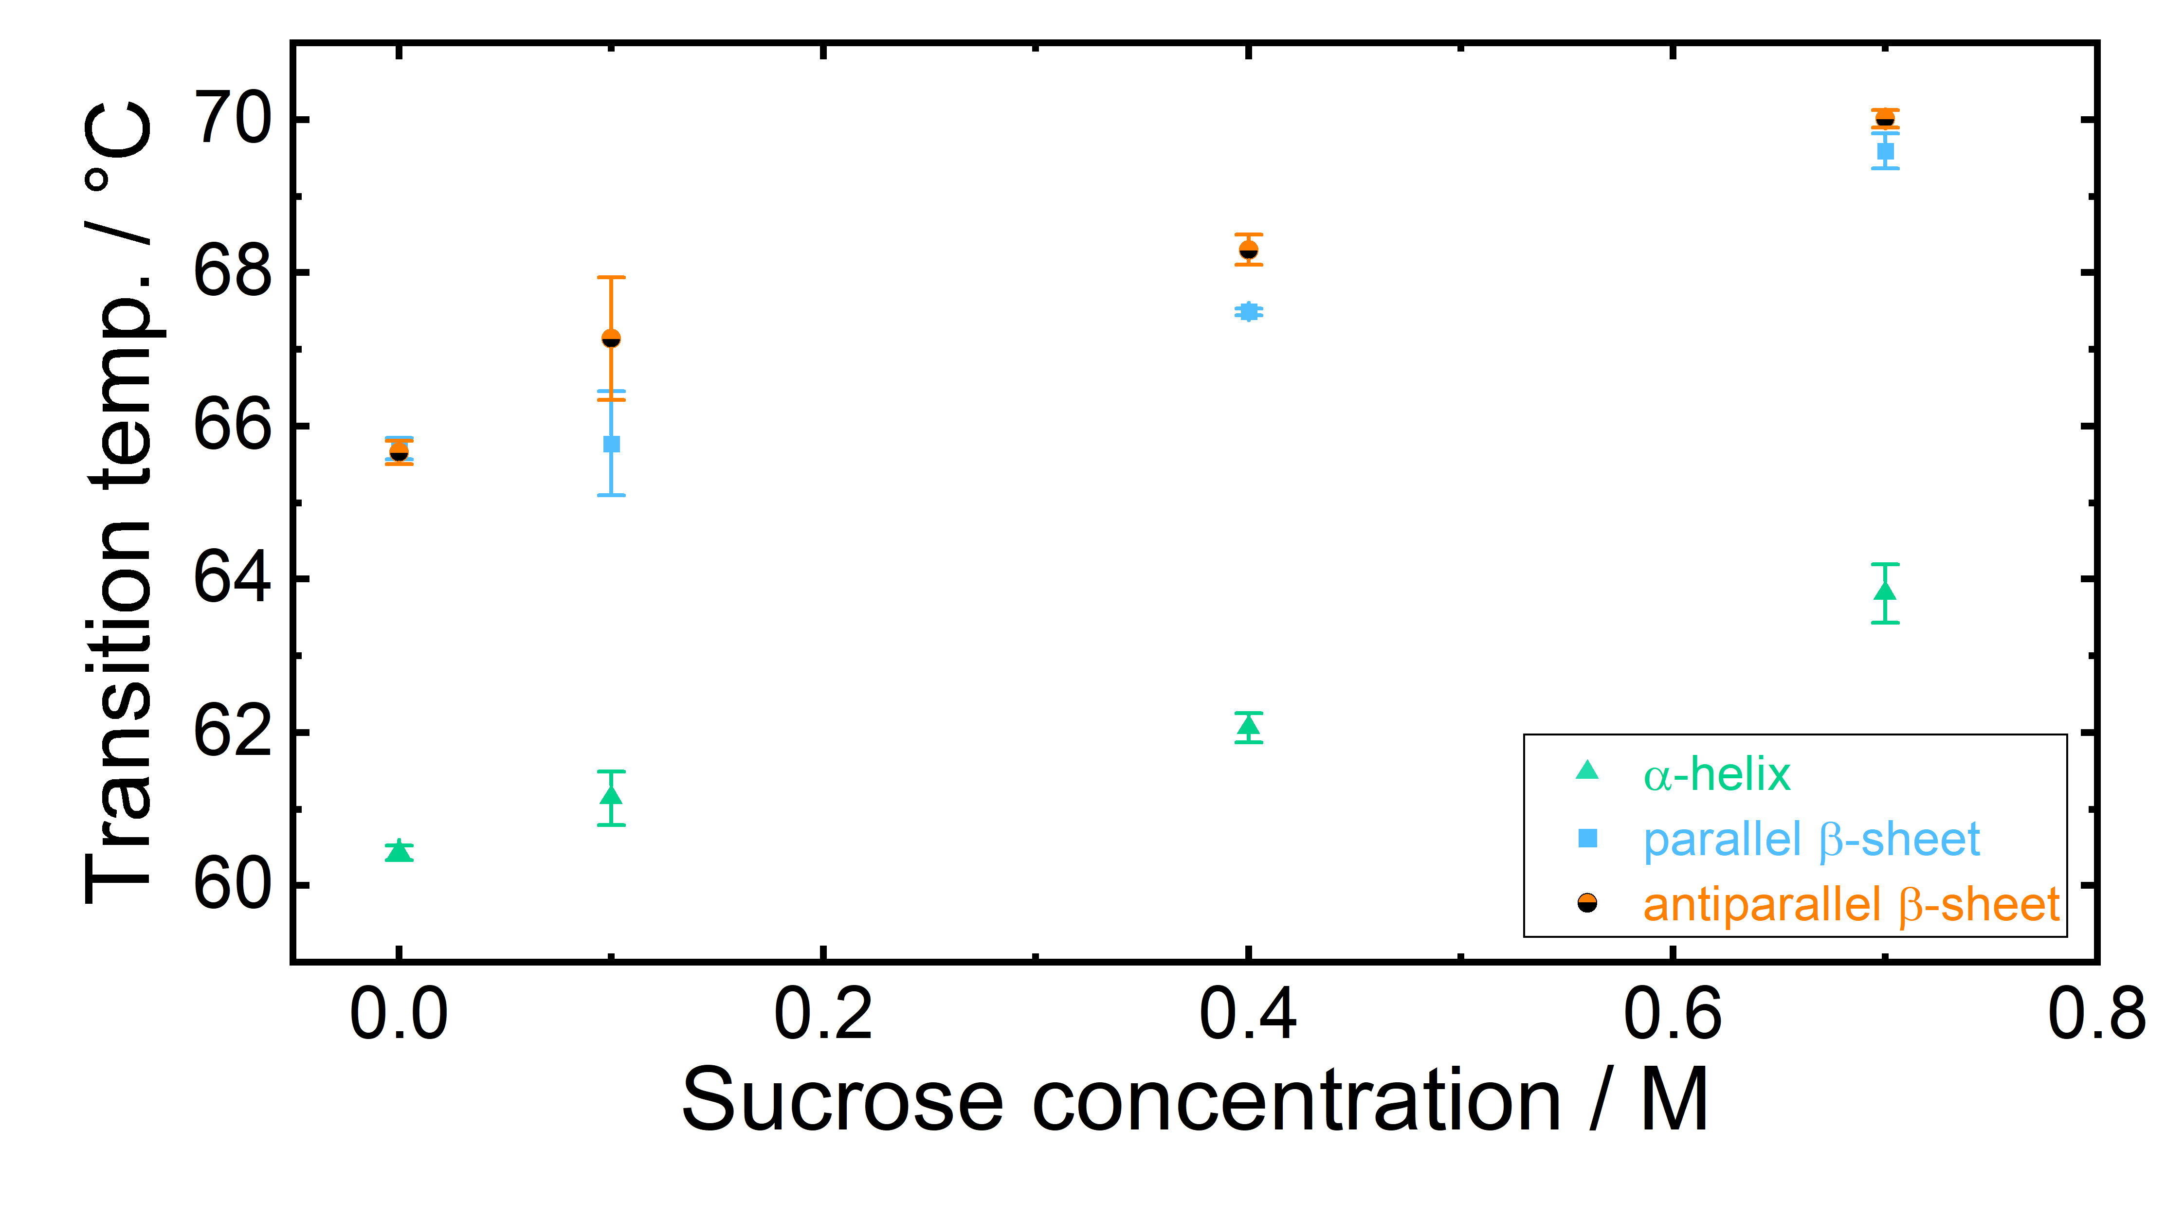
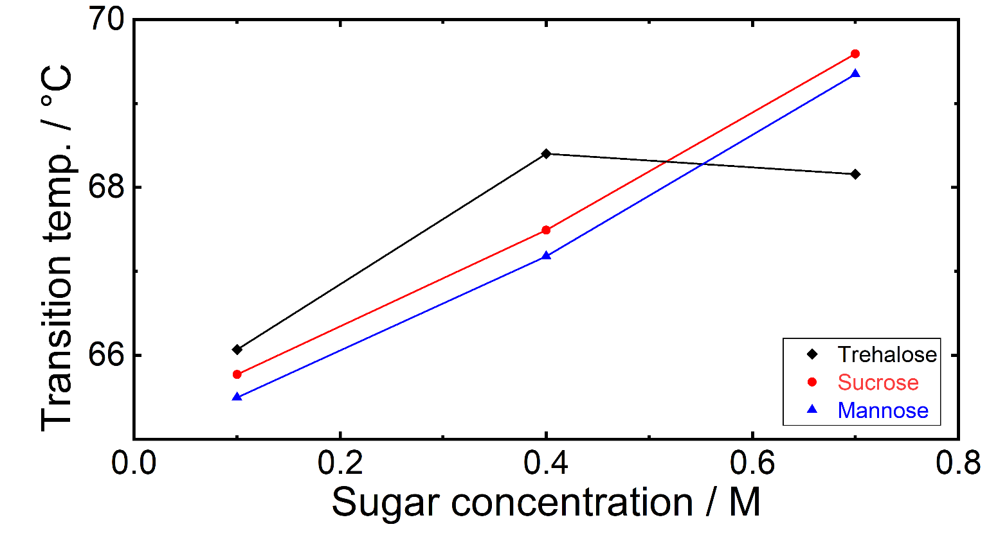

Laser Based Mid-IR Spectroscopy for Monitoring
Temperature-Induced Denaturation of BSA
and Stabilization Effects of Sugars
Shilpa Vijayakumar, Andreas Schwaighofer, Bernhard Lendl
Institute of Chemical Technologies and Analytics, Technische Universität Wien, Getreidemarkt 9, A-1060 Vienna, Austria
E-mail
Website
Upon thermal denaturation, proteins experience a change of secondary structure that can
Introduction
Sensor setup
Upon thermal denaturation, proteins experience a change of secondary structure that can be monitored by IR spectroscopy. Bovine serum albumin (BSA) was used as model protein.
At room temperature, BSA displays an α-helical structure, while at elevated temperatures, the formation of β-sheet structures can be observed [3]. The progression of β-sheet formation can be evaluated to determine the denaturation temperature of proteins.
In this work, an EC-QCL based mid-IR transmission spectrometer was employed to follow spectral changes upon thermal denaturation in BSA solutions and sugar stabilized BSA solutions. For protein solutions, the influence on BSA concentration on the denaturation temperature was investigated. Stabilization effects of three sugars, trehalose, sucrose and mannose, on BSA were studied at different sugar concentrations [4].
Mid-Infrared (IR) spectroscopy has been successfully employed in protein secondary structure and denaturation studies. Typical protein IR spectra depict the characteristic amide I band between 1600-1700 cm⁻¹, arising from the coupled C=O stretching and in-phase N-H bending vibrations of the protein backbone, and amide II band between 1500-1600 cm⁻¹. Of those, the amide I band is most sensitive to protein secondary structure [1].
In conventional Fourier transform (FTIR) spectroscopy, the overlapping strong absorbance of water close to 1640 cm⁻¹ limits the path length to approx. 10 µm due to the used low intensity light sources [2]. High power IR sources such as external cavity quantum cascade lasers (EC-QCL) enable an increase in path length for transmission measurements, and hence more robust sample handling in comparison to traditional FTIR spectroscopy [1].
Experimental Method
Dependence of Transition Temperature
on Protein Concentration
Sigmoidal fit of band heights
Evaluated transition temperatures
Thermal denaturation was investigated at BSA concentrations of 30, 40, 60, 80 and 90 mg/ml. The progression of 2nd derivative band heights was plotted against temperature. A sigmoidal fit was applied to each of the plots and the calculated inflection point was determined to be the denaturation temperature
The concentration of BSA was limited to 90 mg/ml due to the onset of gelation. At protein concentrations below 30 mg/ml, sigmoidal trends did not develop in the investigated temperature range
Denaturation temperature decreases with increasing protein concentration
Transition temperatures of α-helices are lower than those of β-sheet structures and are less affected by protein concentration
Laser based IR transmission measurements were performed using a commercially available EC-QCL based spectrometer, ChemDetect (Daylight Solutions, USA), in the range of 1350 cm⁻¹ to 1750 cm⁻¹
A temperature controlled, transmission flow cell with CaF₂ windows and path length of 25 µm was used to perform IR measurements between 25 and 85 °C using a temperature ramp of 0.05 °C/s
In the first set of experiments, the concentration of BSA was varied in steps between 30 and 90 mg/ml to determine the dependence of denaturation temperature on protein concentration
The next measurement set involved the addition of different sugars in concentrations of 0.1, 0.4 and 0.7 M to a BSA solution of concentration 40 mg/ml
Stabilization Effect of Different Sugars
Protein Spectra
Mannose
Trehalose
Absorbance spectra
2nd der. spectra
Bovine serum albumin (BSA) is a protein that has a native α-helical structure at room temperature, with a characteristic amide I band maximum at 1656 cm⁻¹
On thermal denaturation, it displays a conformational change to β-sheet structures that are linked to aggregation. This transformation manifests on an IR spectrum as the appearance of two bands at 1619 cm⁻¹ and 1692 cm⁻¹
For further evaluation, second derivative spectra were analysed
Sucrose
Transition temperatures of parallel β sheet
All of the studied sugars increase the transition temperature of denaturation and have a stabilizing effect on BSA. The stabilization increases with sugar concentration
At sugar concentrations greater than 0.7 M, the band height progressions no longer follow a sigmoidal trend in the investigated temperature range and hence stabilizing effects were compared only up to this concentration
At lower sugar concentrations, trehalose provides the best stabilization of the three sugars, followed by sucrose and mannose
References
[1] A. Schwaighofer, C.K. Akhgar, B. Lendl, Broadband laser-based mid-IR spectroscopy for analysis of proteins and monitoring of enzyme activity, Spectrochimica Acta Part A: (2021) 119563
[2] A. Barth, Infrared spectroscopy of proteins, Biochim. Biophys. Acta: (2007), 1767, 1073-1101
[3] V. Borzova, K.A. Markossian, N.A. Chebotareva, S.Y. Kleymenov, N.B. Poliansky, K.O. Muranov, V.A Stein-Margolina, V.V. Shubin, D.I. Markov, B.I. Kurganov, Kinetics of Thermal Denaturation and Aggregation of Bovine Serum Albumin, PloS one: (2016), 11(4)
[4] A. Satoshi, I. Hiroki, T.Shinichi, H.Mitsuhiro, Sugar-Mediated Stabilization of Protein Against Chemical or Thermal Denaturation, The Journal of Physical Chemistry B.: (2018), 122
Conclusions & Outlook
Laser baser IR spectroscopy was successfully employed for monitoring the effect of protein concentration and addition of sugars on the thermal denaturation of BSA
Denaturation temperature of BSA decreases with increasing protein concentration due to crowding effects
Addition of sugars leads to stabilization of protein towards thermal denaturation
Results agree with studies employing alternatives to mid-IR spectroscopy regarding stabilization effects of sugars
This work has received funding from the COMET Centre CHASE, which is funded within the COMET − Competence Centers for Excellent Technologies programme by the BMK, the BMDW and the Federal Provinces of Upper Austria and Vienna. The COMET programme is managed by the Austrian Research Promotion Agency (FFG).

