Slide 1
Considering work hardening of metals from perspective of statistical mechanics
Wenwen Wei
Erwin Povoden-Karadeniz
Ernst Kozeschnik
2023-09-05

Slide 2
1. Introduction of work hardening
1.1 Work hardening
during the deformation process, the flow stress of metals increases as the strain due to the increase of dislocations density.
The dislocations configuration evolve as the strain
The tangles are interconnected into (diffuse) ‘cell walls and the less dense regions may be called ‘cells’
The critical points of understanding work hardening is how to appropriately describe the evolution of dislocations
Typical TEM (electron transmission micrographs) of a Cu single crystal deformed in single slip as the strain
U.F. Kocks, H. Mecking. Progress in Materials Science 48 (2003) 171–273

Slide 3
1. Introduction of work hardening
1.2 Kocks-Mecking model
Kocks and Mecking have proposed a one-parameter formulation, which becomes the basis of a variety of work hardening model.
They use s single variable, i.e. the average dislocation density to describe the dislocation evolution during deformation
In Kocks-Mecking model, the evolution rate of dislocation density is composed of two terms: dislocation storage and dynamic recovery rate.
where C₁ and C₂ is the dislocation storage term and dynamic recovery respectively.
A shortcoming of Kocks-Mecking type models is that C₂ are fitted for each alloy composition and microstructure. Consequently, it becomes difficult to draw a physical interpretation on their application.
To solve this, a thermodynamics-based expression for C₂ should be derived.

Slide 4
1. Introduction of work hardening
1.3 Our aim
Our aim is to understand dynamic recovery of the dislocations during deformation(C₂). The dislocations dynamic recovery is composed of at least following three processes:
Annihilation of the dislocations with opposite Burgers vector
Dislocations locking and the unzipping of dislocations locks(immobile dislocations)
Formation of dislocation dipoles and the divorce of dislocation dipole
In our modelling activities, these three processes will be considered from the perspective of statistical mechanics.

Slide 5
2. Statistical description of dislocation dynamics
2.1 The needs of Statistical Mechanics
To solve the equations of motion of dislocations is almost impossible as the number of dislocations is huge (~10¹³).
The subject of statistical mechanics addresses precisely the connection between the microscopic and macroscopic laws without having to solve a large number of equations. From this point of view, one expects that plastic deformation cannot be an exception to the principles of statistical physics.
The question is how much of the formalism well developed in statistical physics literature can be borrowed for description of plastic flow caused by dislocations motion

Slide 6
2. Statistical description of dislocation dynamics
2.2 The basic concepts of Statistical Mechanics
The microstate of a system can be described by a point in the phase space with (q_{s}, p_{s}) = (q₁, …,q_{N}, p₁,…, p_{N}) representing the coordinate and momentum of all particle in the system.
The probability density of finding the system at micrcostate (q_{s}, p_{s}) in the phase space can be expressed as , therefore
The microscopic quantities f (q_{s}, p_{s}) are so highly fluctuating at the microscopic level that one can only measure the equivalent macroscopic quantities as the ensemble average of the microscopic ones
The entropy of the system S can be related to the number of microstate Ω by Boltzmann equation or expressed as the ensemble average of logarithm of probability density

Slide 7
2. Statistical description of dislocation dynamics
2.3 Application to annihilation of the dislocations
E.I Galindo-Nava et al’s model
E.I Galindo-Nava et al use the velocity of a dislocation to define its microstate.
They assume that the velocity of a dislocation can not exceed the speed of sound c and the dislocation can only move with the speed multiples of the mean speed of dislocation <v>.
The number of microstate of the dislocation can be expressed as
The number of microstate of the dislocations system with annihilation events is expressed as
where N_{d} is the number of dislocations within an interaction volume
E.I Galindo-Nava, Acta Materialia 60 (2012) 2615–2624

Slide 8
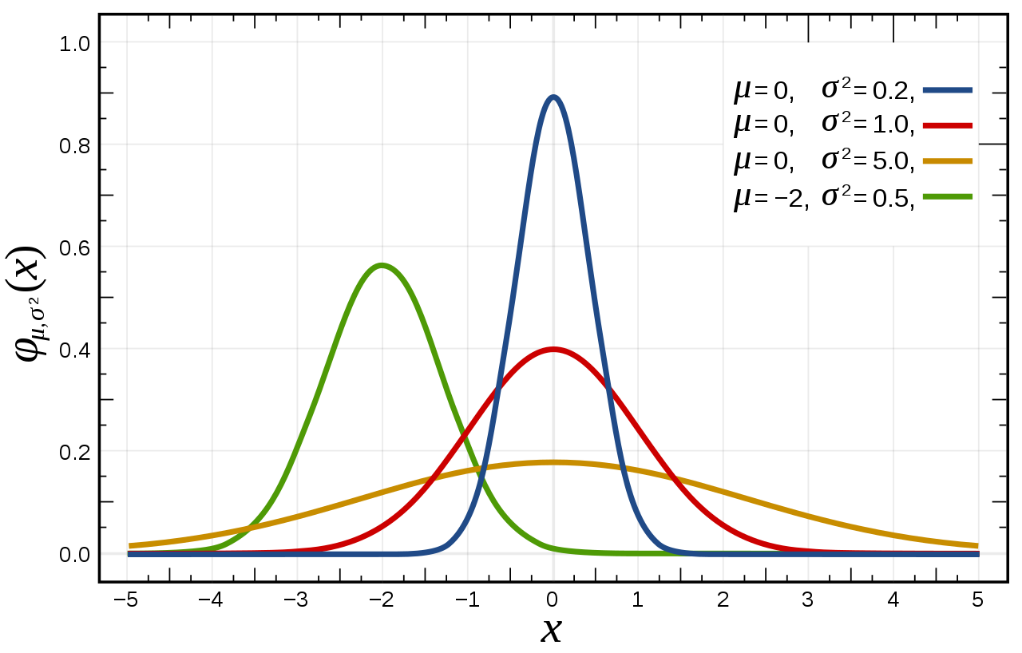
2. Statistical description of dislocation dynamics
2.3 Application to annihilation of the dislocations
The inconsistence of E.I Galindo-Nava et al’s assumption
If the dislocation can only move with the speed multiples of the mean speed of dislocation <v>, how we calculate the mean speed <v>.
The principle of maximum entropy
The dislocation should can also move with the speed lower than the mean speed <v>.
The speed of dislocation should meet the distribution function which corresponding the maximum entropy of the system, i.e. the Gaussian distribution.
Ongoing work
Recheck the principle of maximum entropy
The Monte Carlo simulation of dislocation annihilation

Slide 9
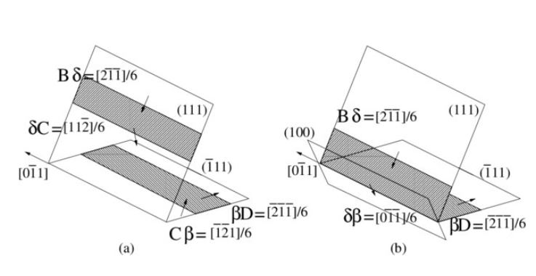
2. Statistical description of dislocation dynamics
2.4 Application to the unzipping of dislocations locks
The generation term of dislocation locks due to the dislocation reaction
The unzipping of dislocations locks
Vasily V. Bulatov et al. Nature Vol 440|27 April 2006: 1174

Slide 10
2. Statistical description of dislocation dynamics
2.5 Application to the dislocation dipoles
The generation term of dislocation dipoles
The divorce of dislocation dipoles

Slide 11
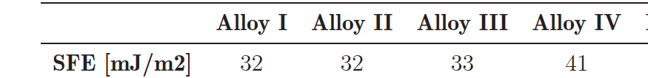
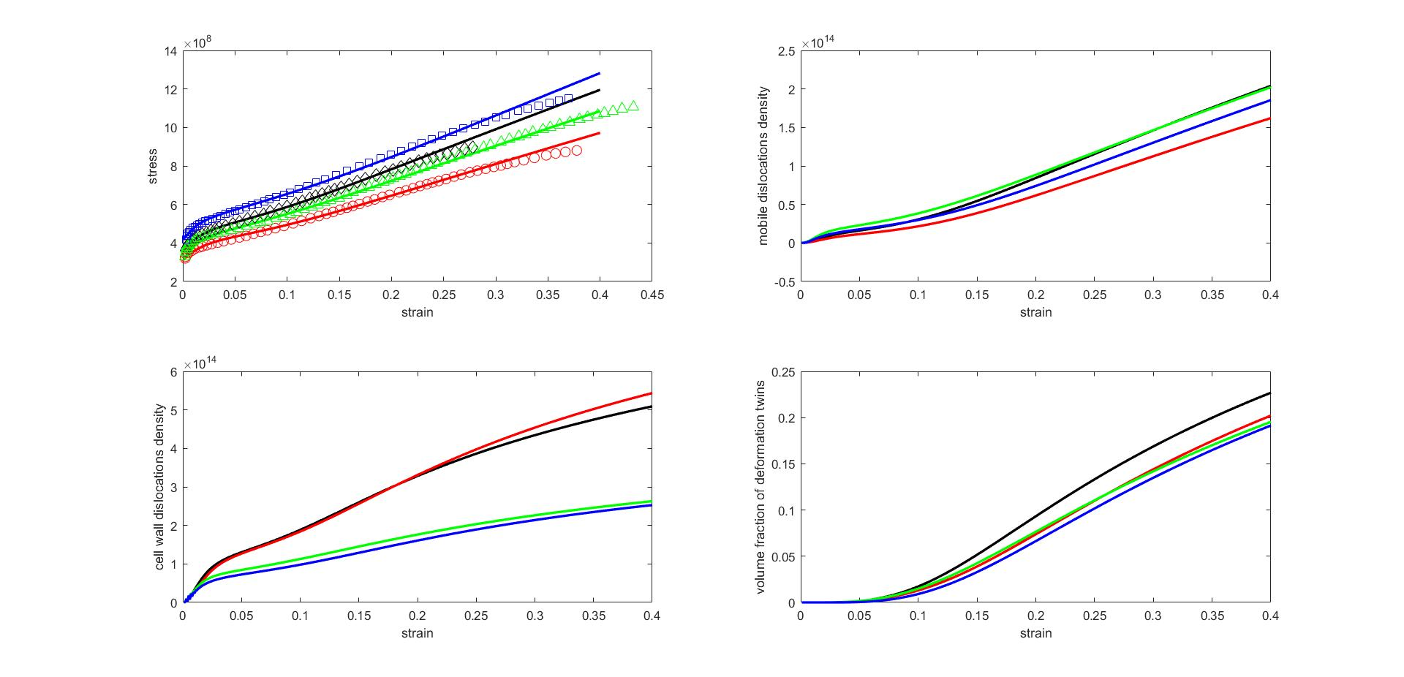
3. The simulation results
Application to high Mn steel
3.1 Chemical composition effects
The flow curve of alloy I, alloy II, alloy III and alloy IV, tensile test at RT and strain rate 0.01/s

Slide 12
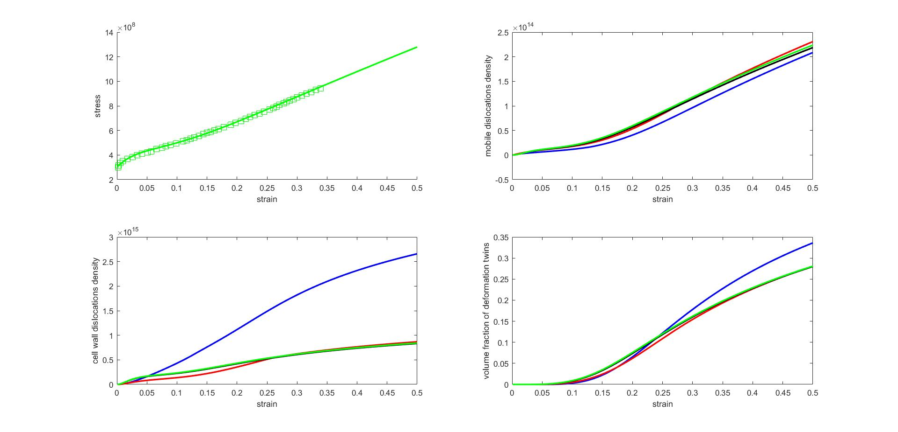
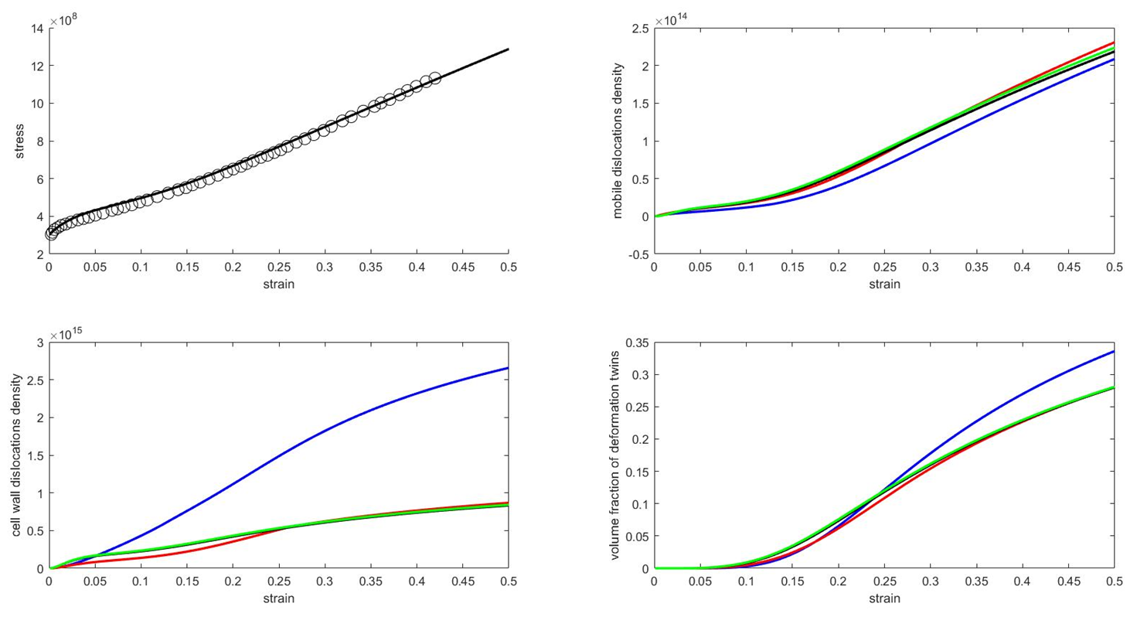
3. The simulation results
Application to high Mn steel
3.2 strain rate effects
True stress-strain tensile curves of Fe-1.05C-11.9Mn-0.03Cr-0.03Al steel at strain rate of 0.00025/s, 0.001/s, 0.01/s and 0. 1/s

Slide 13
4. Conclusion
The three process of dislocations dynamic recovery is considered from the perspective of statistical mechanics
In considering annihilation of the dislocations the distribution function of speed of dislocation is obtained according to the principle of maximum entropy of the system
the unzipping of dislocations locks(immobile dislocations) and the divorce of dislocation dipole are critical for the model to show the strain rate sensitivity, adding the nonlinear effects of work hardening
The model based on statistical Mechanics has been sucesfully applied to the high Mn steels and can predict the flow curves of different steels and at different strain rate

Slide 14
Thanks for your attention!

Slide 15


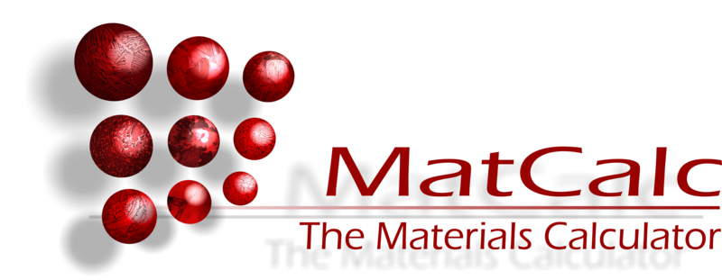
Thanks to …..
The financial support by the Austrian Federal Ministry for Digital and Economic Affairs and the National Foundation for Research, Technology and Development is gratefully acknowledged.
Materials Center Leoben

