Slide 1
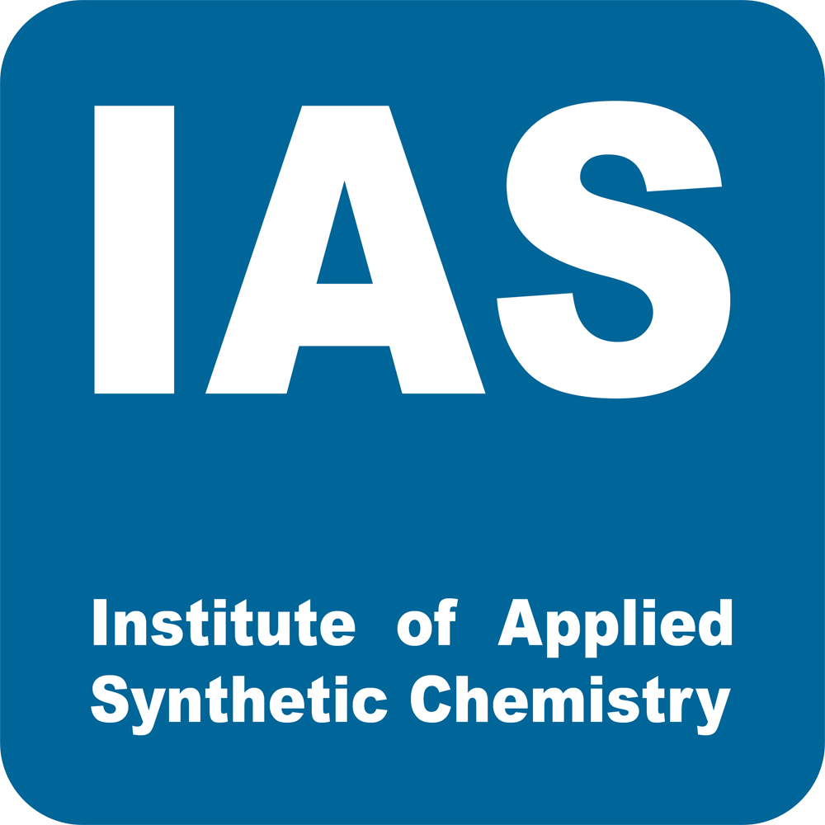
Synthesis of Steroid Long-Term Metabolites used in Doping Analysis
Lecture at DTU March 7th, 2022

Slide 2
Introduction
Phase 1 metabolism:
Hydroxylation, deacylation, demethylation (polarity↑), reduction, hydrogenation
Phase 2 metabolism :
Conjugate formation (polarity↑↑)
1

Slide 3
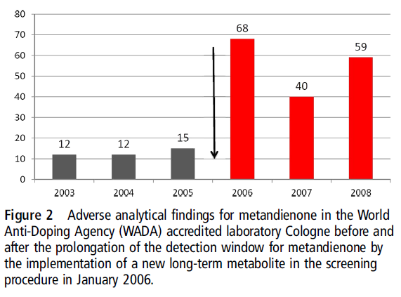
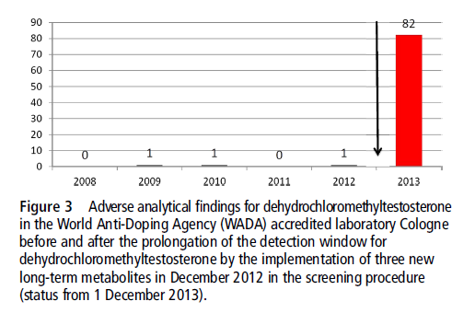
Doping test results
New metabolites increased the number of AAFs significantly
Earlier method for DHCMT: 6β-hydroxy metabolite (detection timeframe: one week)
Samples from earlier competitions are kept frozen and can be reanalyzed with new methods.
2
Geyer H, Schänzer W, Thevis M Br J Sports Med. 2014, 48, 820.

Slide 4
Nightwatch (novel LTM)
Discovered in 2006 as a LTM of metandienone
Rearranged D-Ring substituents
Detection timeframe:
up to 28d
later:
Probably general for 17-methyltestosterone derivatives (= 47% exogenous steroids banned by WADA)
20βOH-NorMD
(Nightwatch)
Schänzer, W.; Geyer, H.; Fußhöller, G.; Thevis, M. et al. Rapid Commun. Mass Spectrom. 2006, 20, 2252.
N. Kratena, V. S. Enev, G. Gmeiner, P. Gärtner Steroids, 2016, 115, 75.
3

Slide 5
Phase 1 LTM targets
oxymesterone
oxymetholone
dehydrochlormethyltestosterone
oxandrolone
OxyM9
OXM M2
M3
Ox M2
M4
Ox M1
Sobolevsky T, Rodchenkov G J. Steroid Biochem. Mol. Biol., 2012, 128, 121.
Guddat S, Fußhöller G, Beuck S, et al. Anal Bioanal Chem. 2013, 405, 8285.
M. Polet, W. V. Gansbeke, L. Geldof, K. Deventer, P. Van Eenoo, Drug Test. Anal. 2017, 9, 1673.
4

Slide 6
Retrosynthetic analysis
Biomimetic Wagner-Meerwein
rearrangement to install C-17
functionalities.
Conditions:
17β:
TMSOTf/lut.
H₃PO₄
17α:
AcOH
H₂SO₄
H₃PO₄
Zn(OTf)₂
β
α
17α-CH₂OH
α
β
17β-CH₂OH
5

Slide 7
Ox M2
Synthetic Ox M2 found to correspond to metabolite found in excretion studies for oxandrolone. Material was passed over to WADA for anti-doping efforts.
N. Kratena, B. Stöger, M. Weil, V.S. Enev, P. Gärtner Tetrahedron Lett., 2017, 58, 1316.
6

Slide 8
Ox M1
Other dehydrating agents:
Martin‘s sulfuran 1 (3:1)
Burgess‘ reagent 2 (2:1)
but lower yields.
N. Kratena, B. Stöger, M. Weil, V.S. Enev, P. Gärtner Tetrahedron Lett., 2017, 58, 1316.
7

Slide 9
DHCMT M3
First two putative metabolites
M3-A and M3-B
Similiar MS data but different
retention times (HPLC/GC)
Possibly stereoisomers
N. Kratena, S.M. Pilz, M. Weil, G. Gmeiner, V.S. Enev, P. Gärtner Org. Biomol. Chem., 2018, 16, 2508
8

Slide 10
DHCMT M3
Divergent synthesis by non-selective Clemmensen reduction → 5α/5β
Epimerisation of
axial chlorine (4α/5α)
N. Kratena, S.M. Pilz, M. Weil, G. Gmeiner, V.S. Enev, P. Gärtner Org. Biomol. Chem., 2018, 16, 2508
9

Slide 11
DHCMT M3
Sequence carried out
with all chlorohydrins
M3-A – M3-H
After comparison with
excretion studies (ES)
M3-H = metabolite M3
3-oxo-1,4-diene steroids were long believed not to form 5α reduced metabolites.
axial OH
N. Kratena, S.M. Pilz, M. Weil, G. Gmeiner, V.S. Enev, P. Gärtner Org. Biomol. Chem., 2018, 16, 2508
10

Slide 12
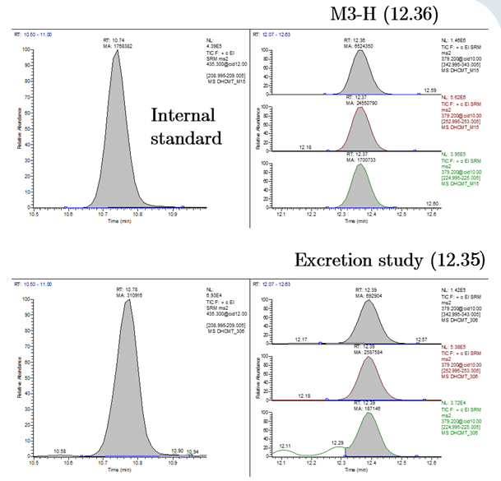
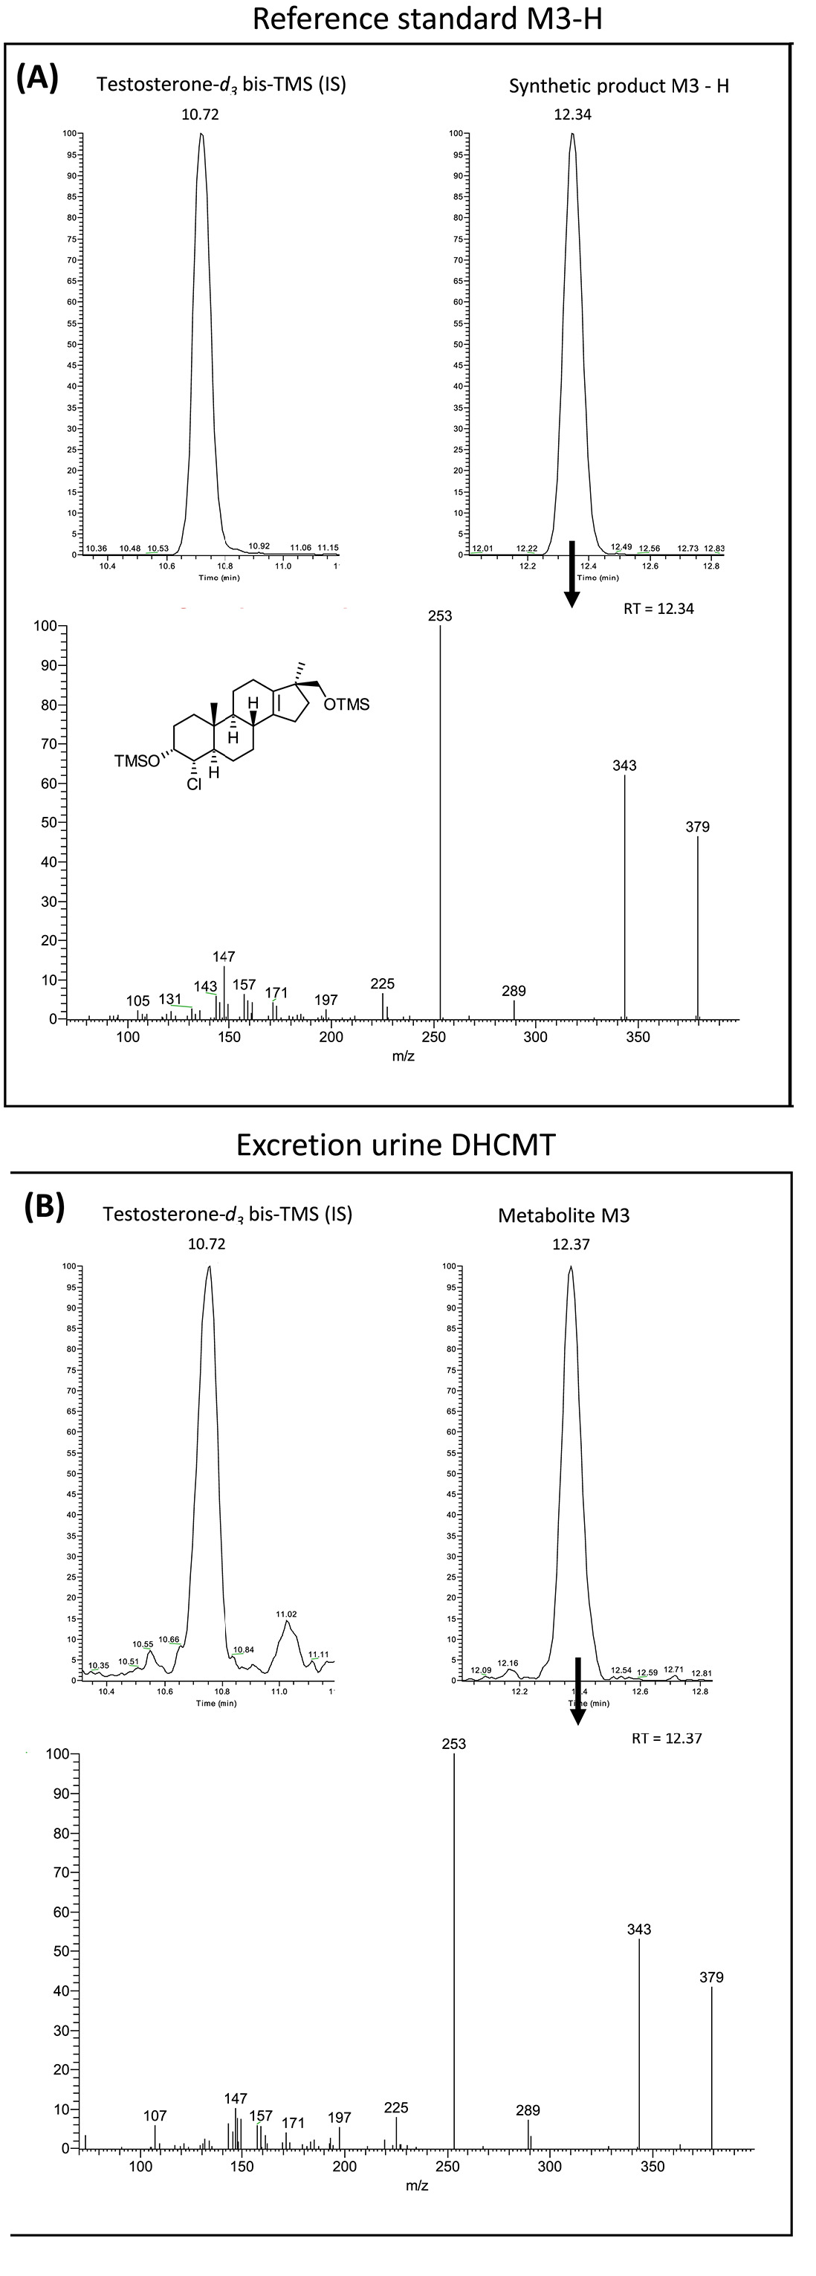
M3-H authenticity
GC-MS/MS (parent ion 379 → 343, 253, 225) from persilylated compounds and methyltestosterone as internal standard.
11
G. Forsdahl, T. Geisendorfer, L. Göschl, S. Pfeffer, P. Gärtner, M. Thevis, G. Gmeiner, Drug Test. Anal. 2018, 10, 1244.

Slide 13
Comparison of 8 stereoisomers
 |  |  |  | TD IDCR Compliance
Compound | Stereochemistry | Retention Time | Transitions (Relative Abundances, %) | Chromatography | Mass Spectrometry
M3 ‐ A (a) | 3α4β5β | 11.83 | 379 → 343 (2), 379 → 253 (100), 379 → 225 (4)
M3 ‐ B (c) | 3α4β5α | 11.83 | 379 → 343 (3), 379 → 253 (100), 379 → 225 (4)
M3 ‐ C (b) | 3β4β5β | 11.92 | 379 → 343 (30), 379 → 253 (100), 379 → 225 (7)
M3 ‐ D (e) | 3β4α5β | 12.07 | 379 → 343 (4), 379 → 253 (100), 379 → 225 (2)
M3 ‐ E (f) | 3α4α5β | 12.24 | 379 → 343 (15), 379 → 253 (100), 379 → 225 (6)
M3 ‐ F (d) | 3β4β5α | 14.43 | 379 → 343 (61), 379 → 253 (100), 379 → 225 (19)
M3 ‐ G (g) | 3β4α5α | 14.20 | 379 → 343 (10), 379 → 253 (100), 379 → 225 (10)
M3 ‐ H (h) | 3α4α5α | 12.36 | 379 → 343 (27), 379 → 253 (100), 379 → 225 (7)
Index of the synthetic publication in brackets
MS Criteria are applied in two as well as on three transitions
Only 1 out of 8 stereoisomers matches the criteria of the WADA TD IDCR
Consequently
The TD IDCR has a high discrimination capability between structurely related compounds
The confirmation method using GC-MSMS is fit for purpose
3
4
5
12

Slide 14
DHCMT M4
5 step synthesis
13% overall M4-D
Comparison with
excretion studies:
M4-D = in vivo M4
Found:
3β-hydroxy
17α-hydroxymethyl
Reported:
3α-hydroxy
17β-hydroxymethyl
13

Slide 15
DHCMT M4 and Oxymesterone
Remaining isomers
M4-A and M4-B
synthesized from DHEA acetate.
OxyM9 accessed
from key intermediate chloroketone 3.
N. Kratena, S. Pfeffer, V. S. Enev, G. Gmeiner, P. Gärtner Steroids, 2020, 164, 108716.
14

Slide 16
Oxymetholone
axial methyl: cannot be introduced by enolate chemistry.
Epoxide
Epimerisation to
equatorial 2α-methyl
when 3-ketone is formed.
N. Kratena, N. Biedermann, B. Stojanovic, L. Göschl, M. Weil, V. S. Enev, G. Gmeiner, P. Gärtner Steroids, 2019, 150, 108430.
15

Slide 17
Oxymetholone
Same sequence, protection of 17-oxo necessary in this series.
X-Ray crystal structures prove stereochemical assignment.
N. Kratena, N. Biedermann, B. Stojanovic, L. Göschl, M. Weil, V. S. Enev, G. Gmeiner, P. Gärtner Steroids, 2019, 150, 108430.
16

Slide 18
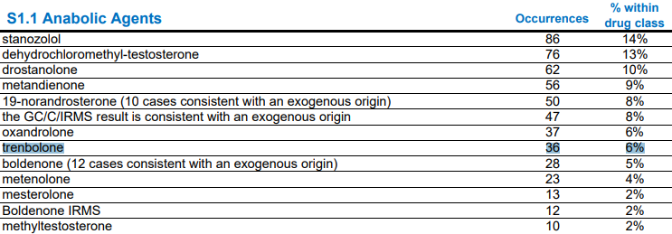
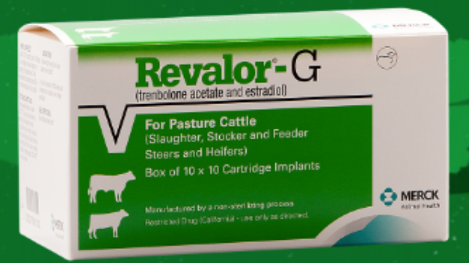
AAS - Trenbolone
Trenbolone is a synthetic AAS
Strong anabolic effect
Used as growth enhancer in cattle
Commonly used in bodybuilding as “tren”
Injected into muscle tissue as esters
6 % of all AAS adverse analytical findings in 2020
Source: 2020 Anti Doping Testing Figures, WADA; https://www.merck-animal-health-usa.com/species/cattle/products/revalor-g-cattle
17

Slide 19
AAS – Trenbolone - Metabolism
18

Slide 20
AAS – Trenbolone - Detection
Longterm metabolite: Epitrenbolone glucuronide, detection window 32 days
Methods of are GC – MS/MS or LC – MS/MS
LC-MS/MS saves two steps but needs epitrenbolone glucuronide reference material
19

Slide 21
AAS – Trenbolone – Synthesis I
Trenbolone not always available from scientific suppliers
Selective reduction of trendione or ester hydrolysis
C-17 stereochemistry inverted by Mitsunobu reaction: Epitrenbolone
20

Slide 22
AAS – Trenbolone – Synthesis II
Metabolic glucuronides always β – glycosidic linkage
Usually achieved through ester protecting groups -> 1,2 trans effect
Problem: Substrates with low nucleophilicity can form orthoesters instead
Trenbolone very prone to orthoester formation
21

Slide 23
AAS – Trenbolone – Synthesis III
Control stereoselectivity without acyl groups?
Bulky TBS-Groups block axial attack and distort ring conformation to twist-boat
Ortho-alkynylbenzoate as leaving group, mild and selective activation with Au[I]
22

Slide 24
AAS – Trenbolone – Synthesis IV
Donor synthesis starts from glucose
6-Step sequence
Selective TEMPO oxidation at C6, bleach as cooxidant
Silylation at C2, C4 is fast, C3 needs 40 °C over 24 h to overcome sterics
23

Slide 25
AAS – Trenbolone – Synthesis V
Conditions: 1.6 eq Donor, 0.3 eq Catalyst, DCM, rt, 2h
Deprotection: TBAF (20 eq) in THF, then add aqueous NaOH
Weakly acidic workup, then RP – chromatography
Product is stored as sodium salt to protect glycosidic bond
24

Slide 26
AAS – Trenbolone – Summary
Longterm metabolite epitrenbolone glucuronide was synthesized
Can now be used as reference substance to establish LC – MS/MS method for trenbolone
Numerous other target compounds remain
Source: 2020 Anti Doping Testing Figures, WADA
25

Slide 27
DHCMT long-term metabolite glucuronides
L. Göschl, G. Gmeiner, P. Gärtner, M. Steinacher, G. Forsdahl, Steroids, 2022, 180, 108979.
26

Slide 28
Derviatization experiments
L. Göschl, G. Gmeiner, P. Gärtner, M. Steinacher, G. Forsdahl, Steroids, 2022, 180, 108979.
27

Slide 29
Parallel reaction monitoring
L. Göschl, G. Gmeiner, P. Gärtner, M. Steinacher, G. Forsdahl, Steroids, 2022, 180, 108979.
28

Slide 30
Fractionation and Confirmation
L. Göschl, G. Gmeiner, P. Gärtner, M. Steinacher, G. Forsdahl, Steroids, 2022, 180, 108979.
29

Slide 31
Comparison of relative abundances
Substance | Transitions | Relative abundance |  | Difference | Maximum tolerance
 | [m/z] | sample | reference |  | window*
Fraction I | 379 --> 253 | 100% | 100% | 0.00% | 90 - 110%
 | 381 --> 253 | 34.30% | 33.50% | 0.90% | 27.5 - 41.2%
 | 381 --> 343 | 10.90% | 8.50% | 2.50% | 5.9 -15.9%
Fraction II | 379 --> 253 | 100% | 100% | 0.00% | 90 - 110%
 | 381 --> 253 | 30.00% | 33.50% | 4.00% | 24.0 - 36.0%
 | 381 --> 343 | 6.00% | 8.50% | 2.50% | 1.0 -10%
Fraction III | 379 --> 253 | 100% | - | - | -
 | 381 --> 253 | 34.10% | - | - | -
 | 381 --> 343 | 10.30% | - | - | -
L. Göschl, G. Gmeiner, P. Gärtner, M. Steinacher, G. Forsdahl, Steroids, 2022, 180, 108979.
30

Slide 32
Results of derivatization experiment
L. Göschl, G. Gmeiner, P. Gärtner, M. Steinacher, G. Forsdahl, Steroids, 2022, 180, 108979.
31

Slide 33
Phase 2 LTM targets
metandienone
stanozolol
Schänzer W, Guddat S, Thomas A, Opfermann G, Geyer H, Thevis M. Drug Test. Anal. 2013, 5, 810.
32

Slide 34
Stanozolol N-Glucuronide
All other methods were unsuccessful (eg.
Silyl-Hilbert-Johnson, Glycosylhydrazone-
1,3-dicarbonyl cyclocondensation)
N₂-Glucuronide
N₁-Glucuronide
L. Göschl, G. Gmeiner, V. Enev, N. Kratena, P. Gärtner, G. Forsdahl, Drug Test Anal., 2020, 12, 1031.
33

Slide 35
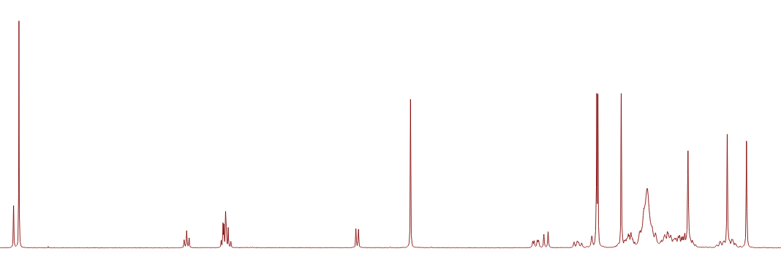
Stanozolol N-Glucuronide
L. Göschl, G. Gmeiner, V. Enev, N. Kratena, P. Gärtner, G. Forsdahl, Drug Test Anal., 2020, 12, 1031.
34

Slide 36
Metandienone LTM Glucuronide
Concise synthesis of 20OH-NorMD metabolites.
N. Kratena, V. S. Enev, G. Gmeiner, P. Gärtner Steroids, 2016, 115, 75.
35

Slide 37
Metandienone LTM Glucuronide
Glucuronolactone
(commercially available)
36

Slide 38
Metandienone LTM Glucuronide
Other methods investigated:
Gluc-Br (Hg²⁺, Ag⁺)
decomposition
Gluc-F (AgClO₄/SnCl₂)
→ No conversion
37

Slide 39
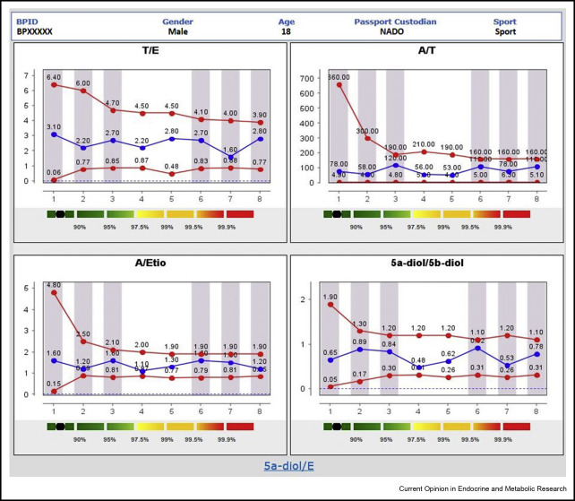
Monitoring of microbiological degradation
Athlete Biological Passport (ABP)
Steroidal module of the Athlete Biological Passport. Ponzetto, Federico, et al. 9, 2019.
38

Slide 40
LTMs of SARMs - Ostarine
Selective Androgen Receptor Modulators
39

Slide 41
Acknowledgements
TU Wien
Dr. Valentin Enev
Dr. Nicolas Kratena
DI. Michael Steinacher
Prof. Christian Hametner (NMR)
Prof. Matthias Weil (X-Ray)
Seibersdorf Laboratories
Dr. Günter Gmeiner
Lorenz Götschl
Prof. Guro Fohrsdahl
40

Slide 42
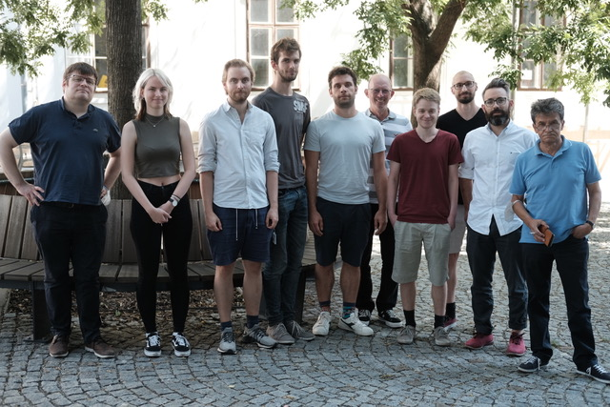
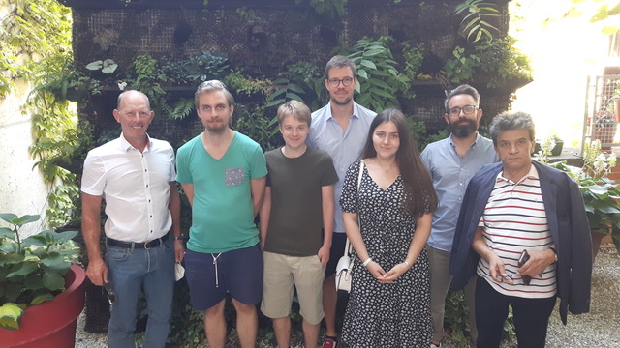
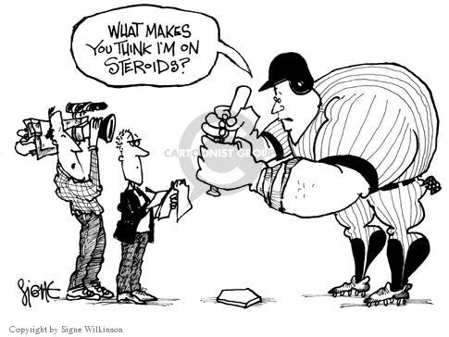
Thanks for your attention
41

