Slide 1
MISATTRIBUTED AFFILIATIONS
COMPARATIVE ANALYSIS OF OPENALEX WITH THREE ESTABLISHED PROPRIETARY DATABASES
Andreas Pacher
10 September 2025 (SOAD, Zürich)

Slide 2




SAMPLE: FOUR DATABASES

Slide 3
WORKS ATTRIBUTED TO TU WIEN (2024):
PRIMA FACIE NUMBERS
3182 works
3151 works
2844 works
2585 works
Notes:
WoS: 2585
OpenAlex: 2844
Scopus: 3151
Dimensions: 3182

Slide 4
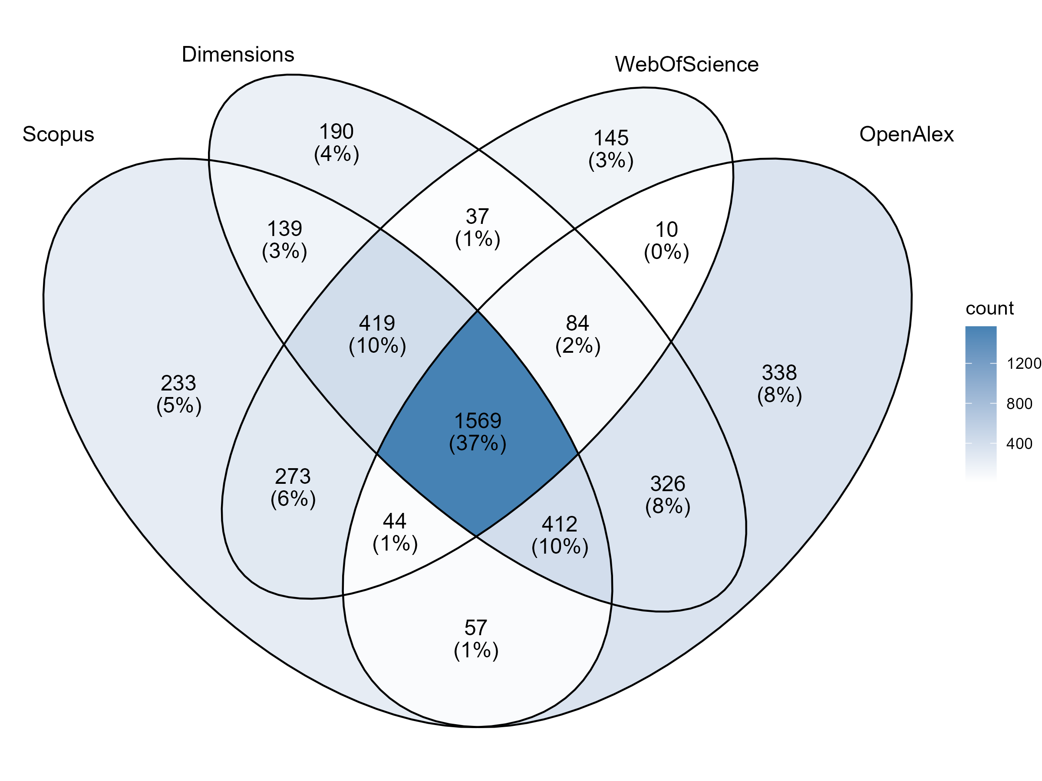
DISCREPANCIES BETWEEN DATABASES
Notes:
WoS: 2585
OpenAlex: 2844
Scopus: 3151
Dimensions: 3182

Slide 5
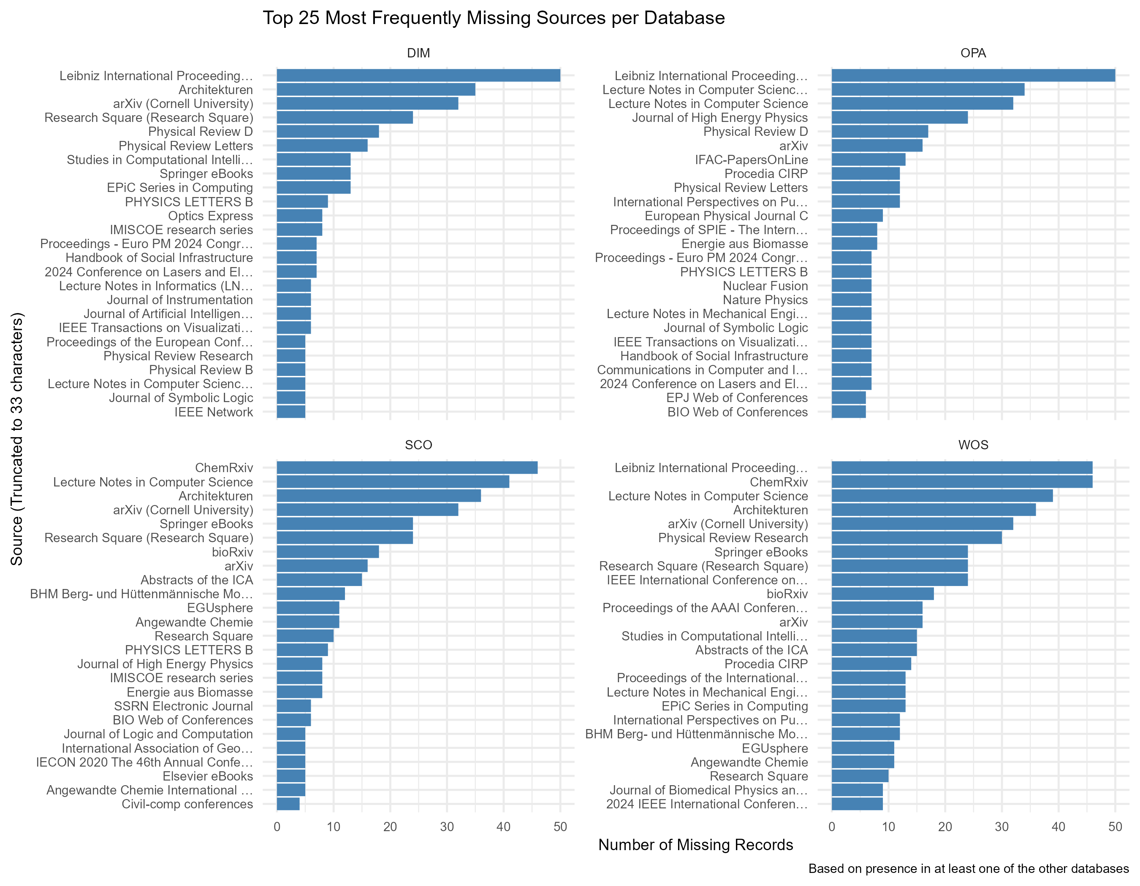
MISSING RECORDS BY SOURCE

Slide 6
MISSING RECORDS BY SOURCE

Slide 7
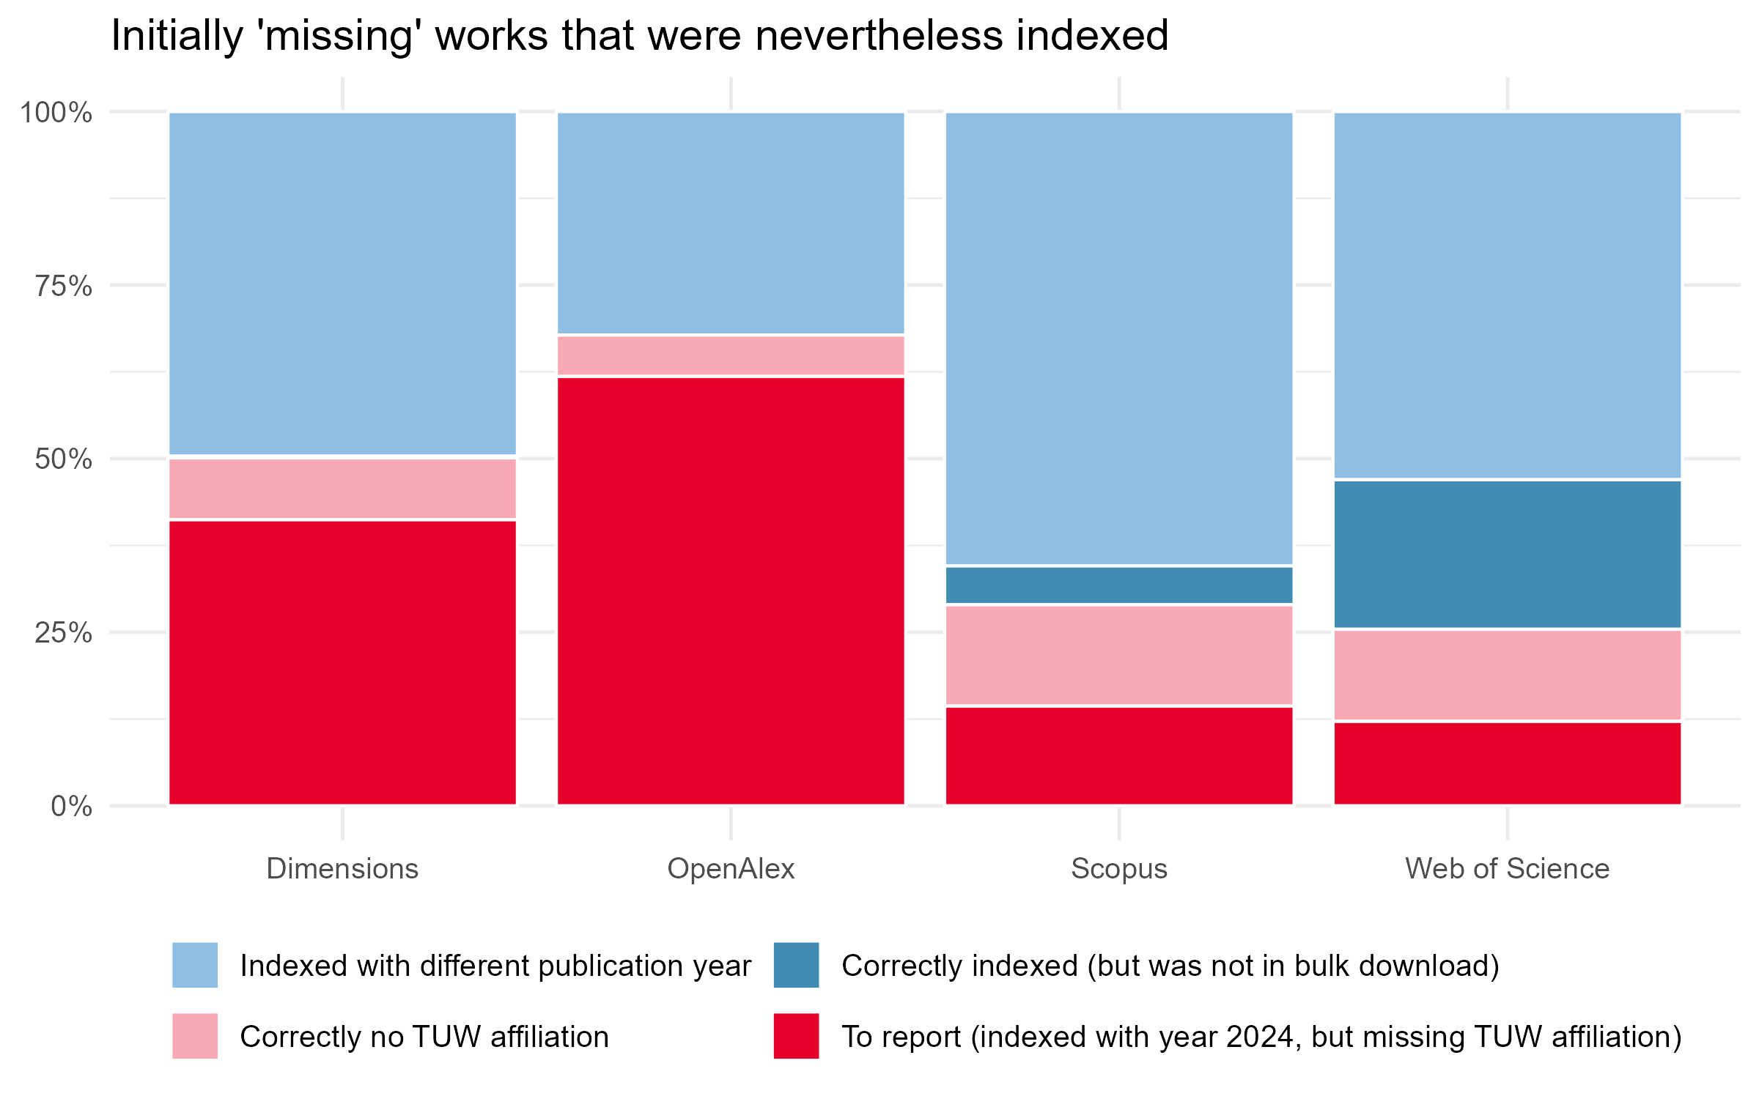
MISSING WORKS – BUT FOUND
402
423
96
269
82
76
23
39
849
351
60
24
59
22

Slide 8
WORKS ATTRIBUTED TO TU WIEN (2024)
+ INITIALLY MISSING BUT INDEXED WORKS
3182
4177
3151
4032
2844
3562
2585
2766
(But these numbers also include conflicting publication years and false positives … )
Notes:
OpenAlex: +47%
Dimensions: +27%
Scopus: +13%
WoS: +7%

Slide 9
WORKS ATTRIBUTED TO TU WIEN (2024)
+ FALSE NEGATIVES
+351
3182
3693
+92
3151
3533
2844
+849
3233
2585
+334
2919
Avg difference = 406,5
Notes:
Avg difference = 406,5

Slide 10
FALSE POSITIVES
402
423
96
269
82
76
?
?
23
39
849
351
60
24
59
22
false positives

Slide 11
FALSE POSITIVES (BY DATABASE)
Most erroneous attributions to TU Wien
1. Web of Science (98)
2. Scopus (56)
3. Dimensions (35)
4. OpenAlex (30)
FH Technikum Wien: 27
JKU: 6
Uni Wien: 3
Uni Wien: 14
TU Graz: 4

Slide 12
TYPOLOGY OF FALASE POSITIVES
Correct affiliation | DOIs affected | Databases
FH Technikum Wien | 27 | Web of Science
Uni Wien | 19 | all
JKU | 6 | Web of Science
TU Graz | 4 | Dimensions
FH Campus Wien | 3 | OpenAlex, Scopus, Web of Science
AIT | 1 | Dimensions
BOKU | 1 | OpenAlex
IT:U | 1 | Scopus and Web of Science

Slide 13

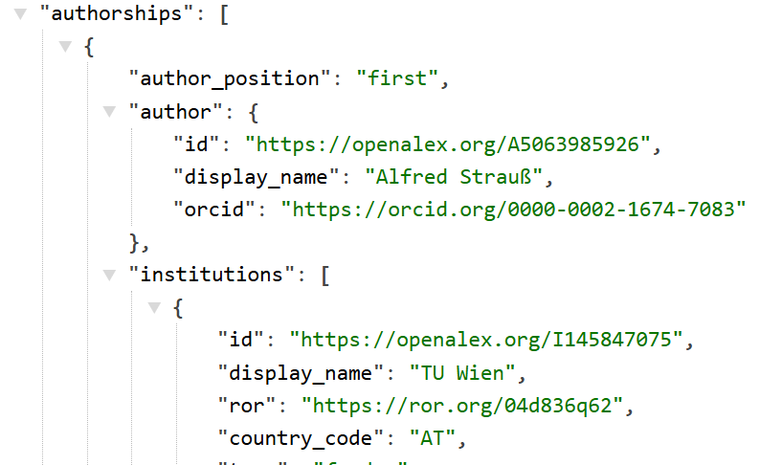

EXAMPLE: BOKU

Slide 14



EXAMPLE: JKU

Slide 15
FALSE NEGATIVES
402
423
96
269
82
76
?
?
23
39
849
351
60
24
59
22
false negatives

Slide 16
REASONS BEHIND FALSE NEGATIVES
reason | n | valid pct (without NA) | pct
wrong use of affiliation name | 225 | 44.1% | 14.3%
mega-authorship | 94 | 18.4% | 6.0%
multiple affiliations | 75 | 14.7% | 4.8%
named institute only rather than TU Wien | 44 | 8.6% | 2.8%
preprint | 26 | 5.1% | 1.6%
syntax, grammar, punctuation | 16 | 3.1% | 1.0%
no affiliation mentioned at all | 12 | 2.4% | 0.8%
unstructured mentioning of affiliation | 10 | 2.0% | 0.6%
unconventional document type | 8 | 1.5% | 0.5%
NA | 1067 |  | 67.7%

Slide 17
REASONS BEHIND FALSE NEGATIVES
reason | n | valid pct (without NA) | pct
wrong use of affiliation name | 225 | 44.1% | 14.3%
mega-authorship | 94 | 18.4% | 6.0%
multiple affiliations | 75 | 14.7% | 4.8%
named institute only rather than TU Wien | 44 | 8.6% | 2.8%
preprint | 26 | 5.1% | 1.6%
syntax, grammar, punctuation | 16 | 3.1% | 1.0%
no affiliation mentioned at all | 12 | 2.4% | 0.8%
unstructured mentioning of affiliation | 10 | 2.0% | 0.6%
unconventional document type | 8 | 1.5% | 0.5%
NA | 1067 |  | 67.7%

Slide 18




MOST FREQUENT MISLABELINGS
166
96
26
Correct forms:
TU Wien
Technische Universität Wien
Notes:
Vienna University of Technology (166)
Technical University of Vienna (96)
TU Vienna (26)
TU Wien (Vienna University of Technology) (26)
Technische Universität Wien (TU Wien) (18)
Technische Univ. Wien (14)
TUWien (8)
University of Technology Vienna (6)
TU Wien – Vienna University of Technology (4)
TU Wein (2)
TU WIEN (2)
Technological University of Vienna (2)
Tu Wien University (2)

Slide 19
REASONS BEHIND FALSE NEGATIVES
reason | n | valid pct (without NA) | pct
wrong use of affiliation name | 225 | 44.1% | 14.3%
mega-authorship | 94 | 18.4% | 6.0%
multiple affiliations | 75 | 14.7% | 4.8%
named institute only rather than TU Wien | 44 | 8.6% | 2.8%
preprint | 26 | 5.1% | 1.6%
syntax, grammar, punctuation | 16 | 3.1% | 1.0%
no affiliation mentioned at all | 12 | 2.4% | 0.8%
unstructured mentioning of affiliation | 10 | 2.0% | 0.6%
unconventional document type | 8 | 1.5% | 0.5%
NA | 1067 |  | 67.7%

Slide 20
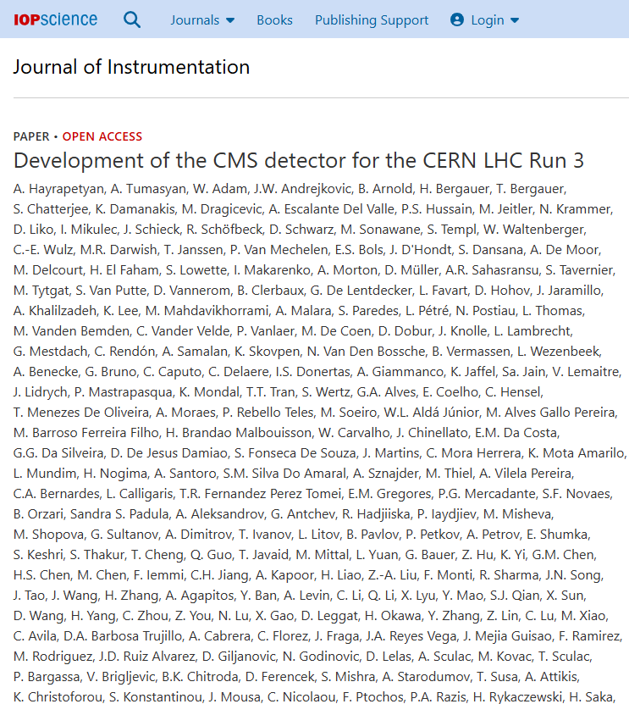

Slide 21
REASONS BEHIND FALSE NEGATIVES
reason | n | valid pct (without NA) | pct
wrong use of affiliation name | 225 | 44.1% | 14.3%
mega-authorship | 94 | 18.4% | 6.0%
multiple affiliations | 75 | 14.7% | 4.8%
named institute only rather than TU Wien | 44 | 8.6% | 2.8%
preprint | 26 | 5.1% | 1.6%
syntax, grammar, punctuation | 16 | 3.1% | 1.0%
no affiliation mentioned at all | 12 | 2.4% | 0.8%
unstructured mentioning of affiliation | 10 | 2.0% | 0.6%
unconventional document type | 8 | 1.5% | 0.5%
NA | 1067 |  | 67.7%

Slide 22
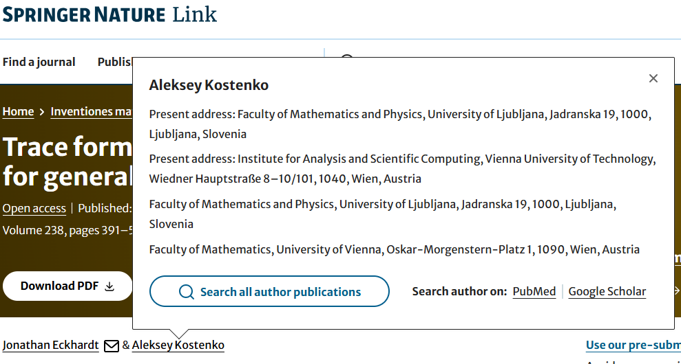
FOUR AFFILIATIONS

Slide 23
REASONS BEHIND FALSE NEGATIVES
reason | n | valid pct (without NA) | pct
wrong use of affiliation name | 225 | 44.1% | 14.3%
mega-authorship | 94 | 18.4% | 6.0%
multiple affiliations | 75 | 14.7% | 4.8%
named institute only rather than TU Wien | 44 | 8.6% | 2.8%
preprint | 26 | 5.1% | 1.6%
syntax, grammar, punctuation | 16 | 3.1% | 1.0%
no affiliation mentioned at all | 12 | 2.4% | 0.8%
unstructured mentioning of affiliation | 10 | 2.0% | 0.6%
unconventional document type | 8 | 1.5% | 0.5%
NA | 1067 |  | 67.7%
Special cases:
Atominstitut
Christian Doppler-Labs

Slide 24
REASONS BEHIND FALSE NEGATIVES
reason | n | valid pct (without NA) | pct
wrong use of affiliation name | 225 | 44.1% | 14.3%
mega-authorship | 94 | 18.4% | 6.0%
multiple affiliations | 75 | 14.7% | 4.8%
named institute only rather than TU Wien | 44 | 8.6% | 2.8%
preprint | 26 | 5.1% | 1.6%
syntax, grammar, punctuation | 16 | 3.1% | 1.0%
no affiliation mentioned at all | 12 | 2.4% | 0.8%
unstructured mentioning of affiliation | 10 | 2.0% | 0.6%
unconventional document type | 8 | 1.5% | 0.5%
NA | 1067 |  | 67.7%

Slide 25
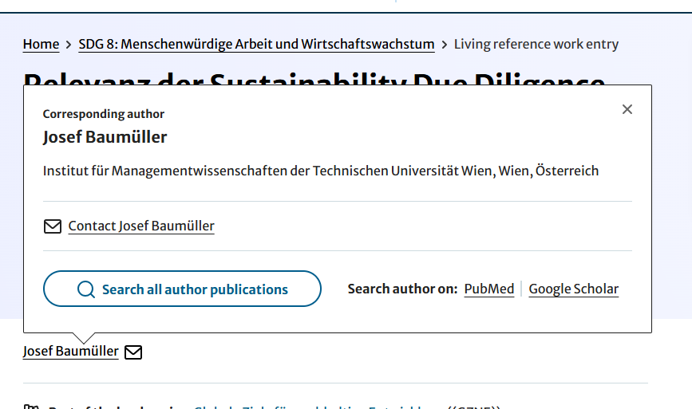
THE USE OF THE GENITIVE

Slide 26

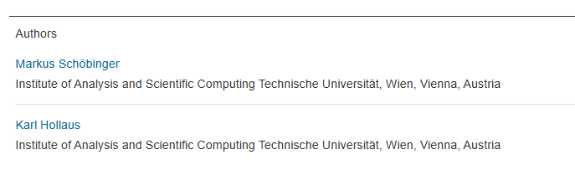
A MISSING COMMA

Slide 27
REASONS BEHIND FALSE NEGATIVES
reason | n | valid pct (without NA) | pct
wrong use of affiliation name | 225 | 44.1% | 14.3%
mega-authorship | 94 | 18.4% | 6.0%
multiple affiliations | 75 | 14.7% | 4.8%
named institute only rather than TU Wien | 44 | 8.6% | 2.8%
preprint | 26 | 5.1% | 1.6%
syntax, grammar, punctuation | 16 | 3.1% | 1.0%
no affiliation mentioned at all | 12 | 2.4% | 0.8%
unstructured mentioning of affiliation | 10 | 2.0% | 0.6%
unconventional document type | 8 | 1.5% | 0.5%
NA | 1067 |  | 67.7%

Slide 28
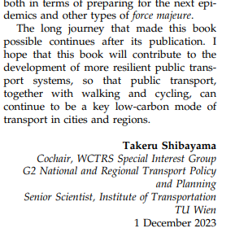


AFFILIATION EMBEDDED
WITHIN FULL TEXT

Slide 29
REASONS BEHIND FALSE NEGATIVES
reason | n | valid pct (without NA) | pct
wrong use of affiliation name | 225 | 44.1% | 14.3%
mega-authorship | 94 | 18.4% | 6.0%
multiple affiliations | 75 | 14.7% | 4.8%
named institute only rather than TU Wien | 44 | 8.6% | 2.8%
preprint | 26 | 5.1% | 1.6%
syntax, grammar, punctuation | 16 | 3.1% | 1.0%
no affiliation mentioned at all | 12 | 2.4% | 0.8%
unstructured mentioning of affiliation | 10 | 2.0% | 0.6%
unconventional document type | 8 | 1.5% | 0.5%
NA | 1067 |  | 67.7%
Errata, Corrigenda
Editorial
List of conference committee members
Workshop programme

Slide 30
REASONS BEHIND FALSE NEGATIVES
reason | n | valid pct (without NA) | pct
wrong use of affiliation name | 225 | 44.1% | 14.3%
mega-authorship | 94 | 18.4% | 6.0%
multiple affiliations | 75 | 14.7% | 4.8%
named institute only rather than TU Wien | 44 | 8.6% | 2.8%
preprint | 26 | 5.1% | 1.6%
syntax, grammar, punctuation | 16 | 3.1% | 1.0%
no affiliation mentioned at all | 12 | 2.4% | 0.8%
unstructured mentioning of affiliation | 10 | 2.0% | 0.6%
unconventional document type | 8 | 1.5% | 0.5%
NA | 1067 |  | 67.7%

Slide 31

OTHER REASONS: EXAMPLE

Slide 32
DATA CORRECTION

Slide 33
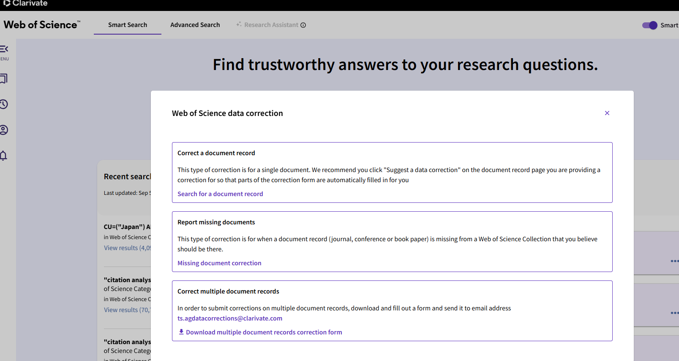
DATA CORRECTION: WEB OF SCIENCE

Slide 34
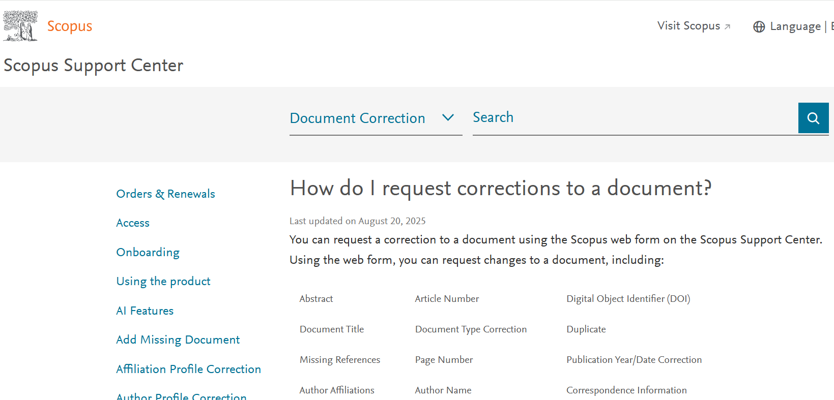
DATA CORRECTION: SCOPUS

Slide 35
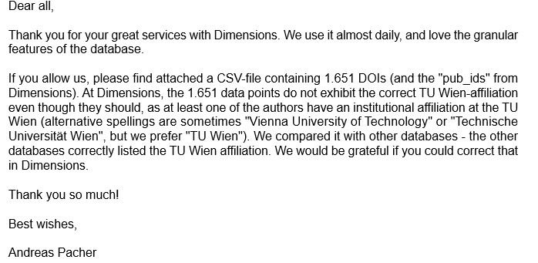
DATA CORRECTION: DIMENSIONS

Slide 36
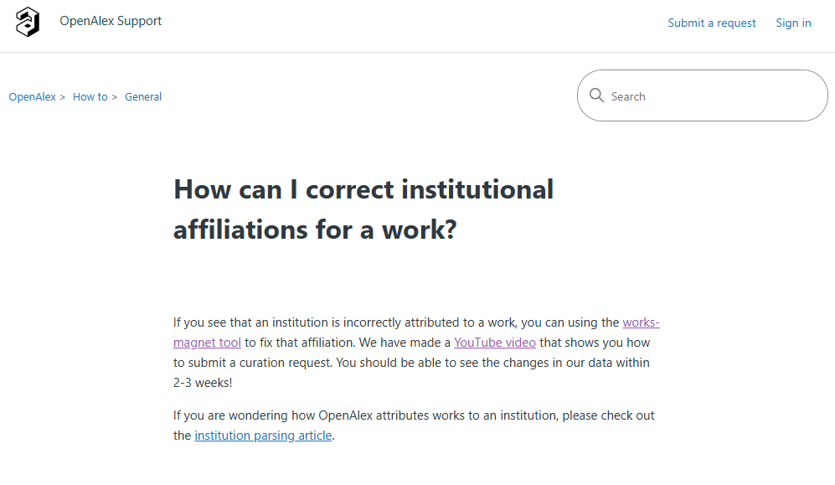
DATA CORRECTION: OPENALEX

Slide 37
CONCLUSIONS

Slide 38
CONCLUSIONS
Ultimately, OpenAlex has the most voluminous coverage of TU Wien works in 2024 …
… even if it was not immediately visible with the initial query
    (something is wrong with the ROR-based retrieval of works…?)
OpenAlex seems to be a reasonable equivalent to the proprietary databases
Ca. 25% of misattributions seem to be caused by wrong affiliation namings
    Since the average number of false negatives per database was 406, this affects ca 100 TU Wien publications per year
Next step: test the possibility to correct affiliation attributions

Slide 39
THANKS!

